Slide 1
Expediting Project Delivery Webinar – Agency Commitments to Internal Coordination and Delivery
October 16, 2017
Kate Kurgan, AASHTO
David Williams, FHWA
Elisha Wright-Kehner, Arkansas DOT
Paul O’Brien, Arizona DOT

Slide 2
SHRP2 & Its Focus Areas
Safety: Fostering safer driving through analysis of driver, roadway and vehicle factors in crashes, near crashes, and ordinary driving.
Renewal: Rapid maintenance and repair of the deteriorating infrastructure using already-available resources, innovations, and technologies.
Capacity: Planning and designing a highway system that offers minimum disruption and meets the environmental, and economic needs of the community.
Reliability: Reducing congestion and creating more predictable travel times through better operations.

Slide 3
Expediting Project Delivery
Expediting Project Delivery identifies 24 strategies for addressing or avoiding 16 common constraints in order to speed delivery of transportation projects.
Strategies Grouped Under Six Objectives:
Improve internal communication and coordination;
Streamline decision-making;
Improve resource agency involvement and collaboration;
Improve public involvement and support;
Demonstrate real commitment to the project; and
Coordinate work across phases of project delivery.

Slide 4
Expediting Project Delivery
Strategy | Stage of Project Planning or Delivery
 | Early Planning | Corridor Planning | NEPA | Design/ROW/ Permitting | Construction
1. Change-control practices |  |  | ● | ● | ●
2. Consolidated decision council |  | ○ | ● | ●
3. Context-sensitive design and solutions | ○ | ○ | ● | ● | ○
4. Coordinated and responsive agency involvement | ○ | ● | ● | ● | ●
5. Dispute-resolution process |  | ○ | ● | ● | ○
6. DOT-funded resource agency liaisons |  | ○ | ● | ●
7. Early commitment of construction funding | ● | ● | ●
8. Expedited internal review and decision-making | ● | ● | ● | ●
9. Facilitation to align expectations up front | ○ | ● | ●
10. Highly responsive public engagement | ● | ● | ● | ● | ○
11. Incentive payments to expedite relocations |  |  |  | ●
12. Media relations manager |  | ● | ● | ● | ○
13. Performance standards | ○ | ● | ● | ●
14. Planning and environmental linkages | ● | ● | ●
15. Planning-level environmental screening criteria | ● | ●
16. Programmatic agreement for Section 106 |  |  | ● | ●
17. Programmatic or batched permitting |  |  | ● | ●
18. Real-time collaborative interagency reviews | ○ | ○ | ● | ○
19. Regional environmental analysis framework | ○ | ● | ● | ●
20. Risk management | ● | ● | ● | ● | ●
21. Strategic oversight and readiness assessment | ○ | ● | ●
22. Team co-location |  | ○ | ● | ●
23. Tiered NEPA process | ○ | ● | ●
24. Up-front environmental commitments |  | ● | ● | ●

Slide 5
Implementation Award Recipients
Arizona Department of Transportation (ADOT)
Arkansas State Highway and Transportation Department (AHTD)
Association of Monterey Bay Area Governments (AMBAG)
California Department of Transportation (Caltrans)
Florida Department of Transportation (FDOT)
Idaho Transportation Department (ITD)
Maricopa Association of Governments (MAG)
Massachusetts Department of Transportation (MassDOT)
Nebraska Department of Roads (NDOR)
South Carolina Department of Transportation (SCDOT)
South Dakota Department of Transportation (SDDOT)
Vermont Agency of Transportation (VTrans)

Slide 6
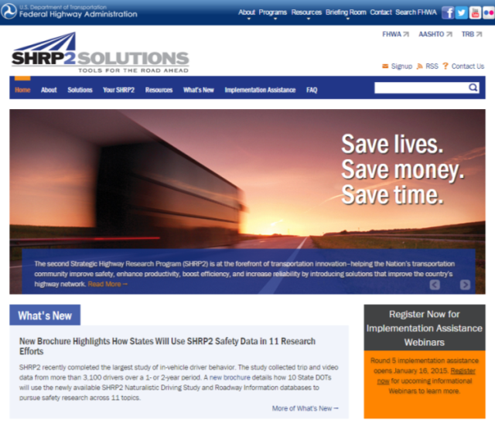
SHRP2 on the Web
GoSHRP2 www.fhwa.dot.gov/GoSHRP2
Apply for Implementation assistance
Learn how practitioners are using SHRP2 products
SHRP2 @AASHTO http://SHRP2.transportation.org
Implementation information for AASHTO members
SHRP2 @TRB www.TRB.org/SHRP2
Research information
FHWA C19 Website https://www.environment.fhwa.dot.gov/strmlng/shrp2-c19/default.asp

Slide 7
AASHTO & FHWA Contacts
Kate Kurgan, AASHTO
kkurgan@aashto.org
202-624-3635
David Williams, FHWA
david.Williams@dot.gov
202-366-4074

Slide 8
A Self-Assessment on Project Delivery in Arkansas
Elisha Wright-Kehner, P.E.
Arkansas Department of Transportation

Slide 9
Why Expediting
Project Delivery (C19)?
C19 Strategies Targeted:
• Improve Public Involvement and Support
• Improve Resource Agency Involvement and
Collaboration
• Demonstrate Real Commitment to the Project
• Improve Internal Communication and
Coordination
• Streamline Decision Making
• Integrate Across all Phases of Project Delivery

Slide 10
History in Arkansas
Award Date - October 17, 2013
Awarded - $50,000
Assessment Workshop - $20,000

Slide 11
Expediting Project Delivery – Assessment Workshop
• Facilitated by FHWA on July 30-31, 2014
• 30 Attendees
• Topics
Overview of the Expediting Project Delivery and the
Expediting Project Delivery Assessment Tool
Overview of “Current State” and “Desired State” of
Project Development and Delivery Processes and
Practices
Collaboration and Coordination Challenges and
Opportunities
“What works well?”
“What needs work?”

Slide 12
What works well at ARDOT?
• Administration Open to Change
• Recent Organizational Changes
• Creation of Preliminary Engineering Squad
• Hiring Qualified Personnel
• Open Communication
• Improved Teamwork
• Good Relationship between ARDOT and FHWA
• Public Engagement

Slide 13
Challenges and Opportunities
Project Development Process Documentation
Personnel changes and work load
Project Change Communication
Early Project Decision Making:
Defining the Purpose and Need
Project Scoping
Local Agencies Communication
Need for standardization and streamline process

Slide 14
Action Plan
Developed an Action Plan in March 2015 to facilitate the activities identified in the Workshop
Five Steps of Implementation:
Refine Scoping Procedure
Enhancing Purpose and Need Statements
Improving Information and Data
Improving Internal and External Communication and Coordination
Evaluating Resource Allocation

Slide 15
Action Steps - 1
Refine Scoping Procedures
A draft project initiation form
Developed in coordination with internal stakeholders.
Expected to be complete and approved in September 2016.
Changes to the Project Initiation Form:
Incorporate the Project Initiation Form into the internal Staff Minutes.
This will reduce a duplication of efforts.
This will also allow each division to add, remove and update their part of the minutes as they deem necessary in real-time.
The Staff Minutes are used Department-wide and every employee has access to them. Updated within an Access Database.

Slide 16
Action Steps - 1
Refine Scoping Procedures
A project planning study process has been developed.
This documented process will help ensure consistency, accuracy, and transparency of the decision making and scoping process.
Planning study procedure manual. ARDOT is using the planning study procedures/guide on all new planning studies and this information is also provided to consultants that work on planning studies for ARDOT.
A data-driven, performance-based approach to better identify system needs.
These documented processes are being refined and updated.
A project prioritization system has recently been implemented to assist decision makers on which projects to prioritize.
The methods to quantify needs and outcomes will be refined.

Slide 17
Action Steps - 2
Enhance Purpose and Need Statements
The project planning study procedure manual will be modified and updated as needed to ensure project P&N statements are tied to the performance-based planning process.
A data-driven, performance-based approach is being implemented to better identify system needs.
A project prioritization system has recently been implemented to assist decision makers on which projects to prioritize.
We conducted a NEPA and Enhanced Purpose and Need Training. Provide guide to consultants and starting communications with locals earlier in process.
Environmental and planning staff are working more closely together on the purpose and need (more collaboration and communication).

Slide 18
Action Steps - 3
Improve Information Exchange and Data Sharing
Improve Communication/Coordination (Internal and External)
A comment documentation process has been recently created for planning studies.
This process will be modified to better document comment resolutions, thereby improving the transparency and documentation of the decision-making process.
Improve Resource Allocation (Internal and Consultant Staff)
The Department’s consultant selection process will be updated in the near future to allow for stream-lined process for non-engineering services.
TPP along with the Department’s Enterprise Data Committee, is currently testing the enterprise information warehouse that was recently established, to ensure that the server will indeed serve as our replication database department wide.

Slide 19
Action Steps - 4
Facilitate Communication & Coordination
Training
Alternative Development, Purpose and Needs Statements – 40 Attendees
Technical Writing – 75 Attendees
Public Involvement – 18 Attendees
NEPA and Enhanced Purpose and Need Training.

Slide 20
Action Steps - 4
Facilitate Communication & Coordination
Development of a Local Public Agency Manual
Completing Date of Winter 2017
Increased the tracking and disbursement of project related information after all supplemental staff meetings.
Still in the process of creating a line of communication for tribes, local public officials, and affected landowners to use throughout the project development process.
Transportation Planning & Policy Division (TPP) has been working more collaboratively with other divisions – not just Environmental, but also Roadway Design, Maintenance, etc. Better communication at the staff level expedites project delivery.

Slide 21
Action Steps - 5
Evaluate resource allocation
Utilize the Department’s Achieving Career Excellence (ACE) program to assist in training on all of these new processes and procedures.
First year of evaluations will be completed October 2017.
Still developing a plan on Managing Consultant Resources.
TPP Division has been working with the Consultant Contracts office to modify the Department’s Consultant Selection Procedures to allow for non-design related services (currently, the Department has procedures intended for engineering services only). Having a simpler procedure would expedite project delivery.

Slide 22
Steps Forward
Incorporate the Project Initiation Form into our Staff Minutes.
Buy in from all participants.
Develop training programs on the ACE platform.
Update the process to allow for stream-lined process for non-engineering services.
Create an on-line format for tribes, local public officials, and affected landowners to use throughout the project development process.
Establish a rotational program to improve coordination between all Divisions.
Develop and implement a plan on Managing Consultant Resources.

Slide 23
Value to Arkansas
Overall
• Assessment Workshop Successful
• Opportunities for Improvement Identified and started to implement these improvements
• Increased Communications
Internal
External

Slide 24
Lessons Learned
• The constant turnover of employees makes it difficult to complete tasks that are handed off each time a person changes positions.
• Employee workloads also have a large impact on task completion.
• Rome wasn’t built in a day.

Slide 25
Arkansas Contacts and References
Elisha Wright-Kehner
Elisha.Wright-Kehner@ardot.gov
(501) 569-2074
Staff Research Engineer, Arkansas Department of Transportation

Slide 26
Quick Reference Guide for expediting project delivery of Local Public Agency (LPA) Federal-Aid Projects
Paul O’Brien, P.E.
Arizona Department of Transportation (ADOT)

Slide 27
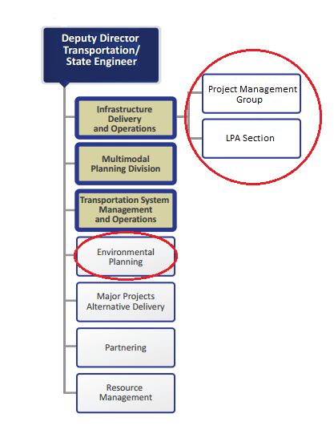
Overview – ADOT Process for FAHP
The LPA is the project sponsor and has staff and consultants
The ADOT LPA Section is tasked with the administration of LPAs
ADOT Project Management Group oversees Design (Project Admin.)
ADOT Environmental Planning is responsible for NEPA compliance (LPA prepares) - can’t be delegated
ADOT Technical Groups
More “layers” of agencies and staff than an “ADOT Project”

Slide 28
Overview - SHRP2, C19 Report
ADOT is a recipient of SHRP2 Implementation Assistance Program for Expediting Project Delivery (Report C19)
SHRP2 research areas focused on:
Renewal, Safety, Reliability, and;
Capacity – develop approaches and tools for systematically integrating environmental … into the analysis, planning , and design of new highway capacity
ADOT’s SHRP2 project was based on “Capacity” within Report C19
The report identified 24 “strategies” for addressing 16 common “constraints” to speed up delivery of transportation projects.

Slide 29
Purpose of ADOT’s SHRP2 Project
ADOT’s SHRP2 project focused on two constraints outlined
in Report C19:
Constraint 16 – “unusually large scale and complex program”
The LPA Program is a large scale and complex program
Constraint 5 – “ineffective internal communication”
Ineffective internal and external communication impacts the delivery of the LPA Program

Slide 30
Purpose of ADOT ‘s SHRP2 Project
SHRP2’s 24 “strategies” were considered
ADOT’s SHRP2 project utilized one strategy theme outlined
in Report C19:
Strategy 21 – “Strategic readiness and oversight assessment”
Program and project management protocols.
Streamlined environmental review through agreements
ADOT’s goal for use of the SHRP2 assistance was to provide a project development tool for expediting LPA project delivery in lieu of formal agreements outlined in Strategy 21
Holistic approach with focus on overall administration
Better overall administration leads to improved environmental review

Slide 31
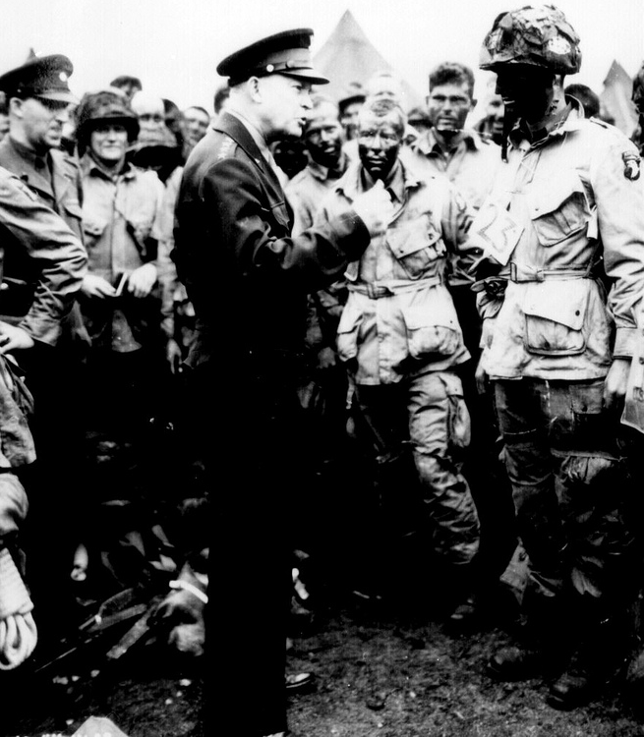
ADOT ‘s SHRP2 Project Model
General Eisenhower - Supreme Allied Commander in WWII
Promoted over many senior Generals (“SMEs”) – Why?
He was recognized for his skills as a:
Collaborator
Communicator
Coordinator
Supply trucks and bulldozers win wars, not just tanks
Logistics and administration
“Basics” underlying the glorious

Slide 32
Example - Communication Breakdown
Sample LPA Project – “Why did it take a year to do the CE?”
2013 –
November - LPA initiated project
December 9 – FHWA authorized PE funds
2014 –
August 19 – LPA asked for the status of the environmental. There was no awareness of the project at Environmental Planning. When did it start? No one communicating?
September 9 – Environmental Planning informed the PM that they need basic project information to prepare a clearance
November 14 – Environmental Planning sent an email to the LPA Section noting that they had been waiting for the a scope of work. Why the wait?
November 25 – CE was prepared and sent to LPA Section for project info confirmation
December 15 – CE was approved

Slide 33
Identification of issues
ADOT LPA Section has developed the Local Public Agency Project Manual which provides information and guidance for FAHP delivery – Informative but large
Many basic things have to be “learned” with each new project:
What are the steps?
Who is responsible for what?
Who needs to communicate to who?
Can the LPA consultant communicate with ADOT directly?
Initial consultant scope of work is inadequate (or even over-done).
Additional scope identified, but the need not timely communicated.
Project work on the project is delayed or stops until the funds are available.

Slide 34
Identification of issues
We needed a new tool to help bridge the gaps for managing project development in the LPA Program and improving communication.

Slide 35
Addressing the Constraints
Quick Reference Guidance (QRG)

Slide 36
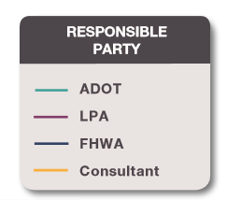
Addressing the Constraints
The Quick Reference Guidance (QRG) was developed to present simplified strategies of the project development process.
The QRG quickly conveys key point of the ADOT Local Public Agency Projects Manual.
The QRG serves the LPA PMs, ADOT PMs, consultants, and everyone involved in the LPA projects.
Throughout the QRG responsible parties identified with different colors
Throughout the QRG communication and
coordination between all the players emphasized

Slide 37
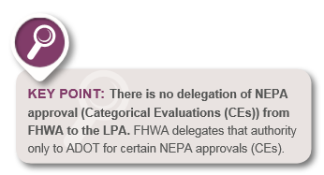
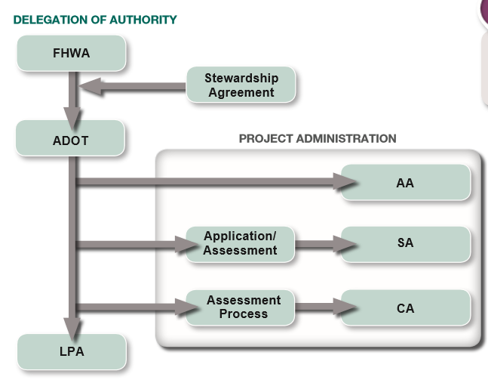
Delegation Authority for LPA projects
The QRG identifies the flow of the delegation authority.
ADOT delegates administration of FAHP either through Self –Administration Agreement ( SA) or Certification Acceptance Agreement (CA).

Slide 38
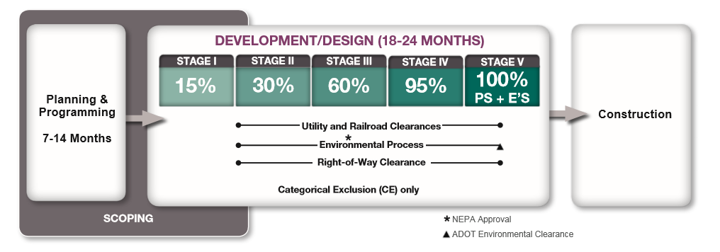
Overview- ADOT Project Development Process
The QRG presents an overview of the anticipated timelines for the project development process including NEPA Approval and ADOT Environmental Clearance.

Slide 39
NEPA Approval and ADOT Environmental Clearance
The QRG highlights “Key Points” in the process
Clarifies the definitions and actions involved with the NEPA Approval and ADOT Environmental Clearance

Slide 40
Initiating ADOT Administered LPA project
The QRG introduces a New Step in the process:
Notification of the project initiation and identification of the ADOT Environmental Planner early on

Slide 41
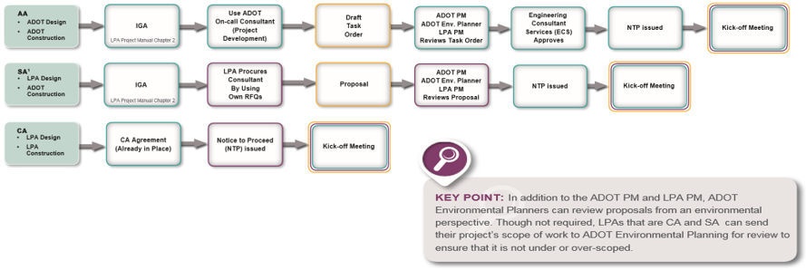
ADOT IGA and Consultant Procurement
The QRG highlights that consultant procurement is dependent on the type of project administration.
The QRG introduces a New Step in the process: ADOT Environmental Planner can review the consultant proposal.

Slide 42
Assistance During Scoping Phase
The QRG stresses that ADOT Environmental Planning involvement in LPA projects can begin as early as preliminary scoping during planning and programming phase.
ADOT encourages LPAs to conduct preliminary scoping early and as thoroughly as possible to evaluate cost estimates before the projects are included in a TIP to ensure that sufficient funding is secured.
ADOT Environmental Planning can be contacted during scoping pre-TIP and post-TIP to provide assistance on NEPA requirements.

Slide 43
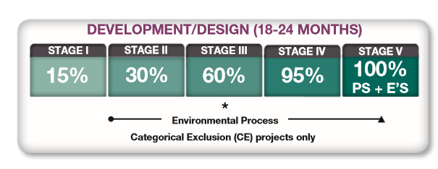
Assistance During Development Phase
Preliminary Engineering , the environmental review process, and NEPA approval occur within the Development/Design Phase
Various environmental analysis may be required and coordination between disciplines is essential.
Identifying and managing the project critical path, meaning accounting for the “other environmental laws” such as NHPA, ESA, CWA, Section 4(f), is also essential, because these typically dictate the environmental component of a project schedule. Communicate changes to the Project Team.

Slide 44
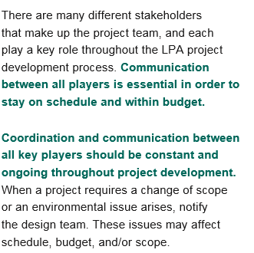
Coordination and Communication

Slide 45
Coordination, Communication, Documentation, QA/QC
The QRG introduces a New Step in the process:
Creating a communication protocol upfront for all projects, so all team members know the communication chain.
The QRG lays out the steps to be taken when communication breakdown occurs. Don’t wait!
LPAs and consultants are encouraged to consult the ADOT Environmental Planning Quality Control Plan.
http://azdot.gov/business/environmental-planning/additional-resources
The approach to project should always be to keep quality in mind from the beginning.

Slide 46
Summary – Expediting Project Delivery
Challenge – expediting environmental review for LPA Program
ADOT SHRP2 took a holistic approach to the solution – Look at “constraints” in overall process not just “environmental”
QRG created as a tool for all members of a Project Team
QRG – easy access to key points of the process
Emphasize earlier involvement of key Project Team staff
Emphasize early scoping and budgets to support Design
Emphasis on the importance of communication – connected Project Team to overcome additional “layers” with LPA Projects
Highlight Key Points for easy access to Project Team
Result: Expediting Project Delivery

Slide 47
Arizona DOT Contacts and References
Paul O’Brien, P.E., pobrien@azdot.gov
ADOT Environmental Planning Administrator
Jodi Rooney, jrooney@azdot.gov
Manager, ADOT Local Public Agency Program
Eunice Chan, P.E., eunice.chan@dot.gov
FHWA Area Engineer, Local Public Agency Program Coordinator
Additional Information:
FHWA (SHRP2) C19 Product: Expediting Project Delivery
https://www.environment.fhwa.dot.gov/strmlng/shrp2-c19/default.asp
ADOT Environmental Planning Website
https://www.azdot.gov/business/environmental-planning

Slide 48
Questions?
Please remember to type in your questions to the question prompt.
Thank you for participating!

Slide 49
Presenter Contacts
Kate Kurgan, AASHTO
kkurgan@aashto.org
202-624-3635
David Williams, FHWA
david.Williams@dot.gov
202-366-4074
Elisha Wright-Kehner,
Arkansas DOT
Elisha.Wright-Kehner@ardot.gov
501-569-2074
Paul O’Brien, Arizona DOT
PO’Brien@azdot.gov
602-712-8669

