Slide 1
Expediting Project Delivery Webinar – Implementing Streamlining Measures
December 11, 2017
Kate Kurgan, AASHTO
David Williams, FHWA
Peggy Laurenz & Dave Huft, South Dakota DOT
Georgi Celusnek, Florida DOT

Slide 2




SHRP2 & Its Focus Areas
Safety: Fostering safer driving through analysis of driver, roadway and vehicle factors in crashes, near crashes, and ordinary driving.
Renewal: Rapid maintenance and repair of the deteriorating infrastructure using already-available resources, innovations, and technologies.
Capacity: Planning and designing a highway system that offers minimum disruption and meets the environmental, and economic needs of the community.
Reliability: Reducing congestion and creating more predictable travel times through better operations.

Slide 3
Expediting Project Delivery
Expediting Project Delivery identifies 24 strategies for addressing or avoiding 16 common constraints in order to speed delivery of transportation projects.
Strategies Grouped Under Six Objectives:
  Improve internal communication and coordination;
  Streamline decision-making;
  Improve resource agency involvement and collaboration;
  Improve public involvement and support;
  Demonstrate real commitment to the project; and
  Coordinate work across phases of project delivery.

Slide 4
Expediting Project Delivery
Strategy | Stage of Project Planning or Delivery
 | Early Planning | Corridor Planning | NEPA | Design/ROW/ Permitting | Construction
1. Change-control practices |  |  | ● | ● | ●
2. Consolidated decision council |  | ○ | ● | ●
3. Context-sensitive design and solutions | ○ | ○ | ● | ● | ○
4. Coordinated and responsive agency involvement | ○ | ● | ● | ● | ●
5. Dispute-resolution process |  | ○ | ● | ● | ○
6. DOT-funded resource agency liaisons |  | ○ | ● | ●
7. Early commitment of construction funding | ● | ● | ●
8. Expedited internal review and decision-making | ● | ● | ● | ●
9. Facilitation to align expectations up front | ○ | ● | ●
10. Highly responsive public engagement | ● | ● | ● | ● | ○
11. Incentive payments to expedite relocations |  |  |  | ●
12. Media relations manager |  | ● | ● | ● | ○
13. Performance standards | ○ | ● | ● | ●
14. Planning and environmental linkages | ● | ● | ●
15. Planning-level environmental screening criteria | ● | ●
16. Programmatic agreement for Section 106 |  |  | ● | ●
17. Programmatic or batched permitting |  |  | ● | ●
18. Real-time collaborative interagency reviews | ○ | ○ | ● | ○
19. Regional environmental analysis framework | ○ | ● | ● | ●
20. Risk management | ● | ● | ● | ● | ●
21. Strategic oversight and readiness assessment | ○ | ● | ●
22. Team co-location |  | ○ | ● | ●
23. Tiered NEPA process | ○ | ● | ●
24. Up-front environmental commitments |  | ● | ● | ●

Slide 5
Implementation Award
Recipients
Arizona Department of Transportation (ADOT)
Arkansas State Highway and Transportation Department (AHTD)
Association of Monterey Bay Area Governments (AMBAG)
California Department of Transportation (Caltrans)
Florida Department of Transportation (FDOT)
Idaho Transportation Department (ITD)
Maricopa Association of Governments (MAG)
Massachusetts Department of Transportation (MassDOT)
Nebraska Department of Roads (NDOR)
South Carolina Department of Transportation (SCDOT)
South Dakota Department of Transportation (SDDOT)
Vermont Agency of Transportation (VTrans)

Slide 6

SHRP2 on the Web
GoSHRP2
www.fhwa.dot.gov/GoSHRP2
  Apply for Implementation assistance
  Learn how practitioners are using SHRP2 products
SHRP2 @AASHTO http://SHRP2.transportation.org
  Implementation information for AASHTO members
SHRP2 @TRB www.TRB.org/SHRP2
  Research information
FHWA R10 & C19 Websites
https://www.fhwa.dot.gov/GoSHRP2/Solutions/Renewal/R10
https://www.environment.fhwa.dot.gov/strmlng/shrp2-c19/default.asp

Slide 7


AASHTO & FHWA Contacts
Kate Kurgan, AASHTO
kkurgan@aashto.org
202-624-3635
David Williams, FHWA
david.Williams@dot.gov
202-366-4074

Slide 8

Implementing Streamlining Measures
Peggy Laurenz & Dave Huft
South Dakota Department of Transportation
December 11, 2017

Slide 9
C19 Assessment Workshop
Participants
“Constraints”
SDDOT
FHWA SD Division
FHWA Resource Center
USDOT Volpe
Conflicting Resource Values
Inability to Maintain Agreement
Insufficient Public Engagement
Lack of Dedicated Staff
Large/Complex Projects

Slide 10
Strengths & Opportunities
Strengths
Challenges & Opportunities
Empowered workforce
Management systems
Scoping process
Public engagement
Open, iterative STIP process
Commitment to process improvement
Strategic planning
Public communication
ITS process integration
Environmental commitment tracking
Project scheduling
Staff size
Staff turnover
Local gov’t coordination
Risk identification in scoping

Slide 11
Five Actions
SHRP2 C19
Other
Enhance public interaction
Increase schedule accountability and allocate internal resources
Coordinate with
External Partners
    Railroads (R16)
    Utilities (R15B)
  Build Internal & External Capacity
    Training
    Mentoring
    Onboarding
  Improve Scoping

Slide 12
Public Engagement:
Public Meetings
Strategies
Survey Topics
Public meeting workflow
Stronger advertising
Personal outreach
Better preparation
Public meeting survey
Date & Location
How aware of meeting?
Reason for interest
Meeting quality
    Purpose clearly explained
    Information clarity
    Free to comment
    Questions answered
  How to improve?

Slide 13
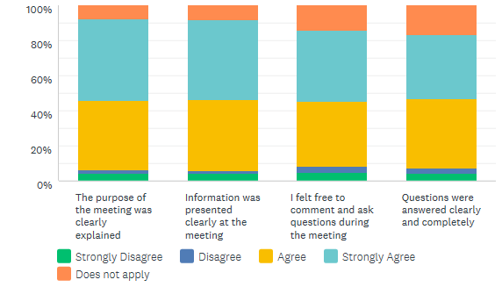
Sample Survey Results

Slide 14
Public Engagement:
Landowner Communication Survey
Location & Project
Pre-construction communication
    Nature of work
    Adequately informed
    Opportunity to ask questions, express concerns
Communication during construction
SDDOT staff contact
    Accessible
    Timely
    Accurate
    Courteous
Public meetings
Preferred communication
Did well / Do better
Overall satisfaction

Slide 15
Project Delivery / Scheduling
SDDOT created a “Project Delivery Office” to place emphasis on timely project delivery
Mission: Ensure all pre-construction projects are delivered to Bid Letting on the schedule intended so we can meet STIP dates

Slide 16
Understanding
What we know, what we need, what we do….
First Steps: Self Evaluation
  understand our processes
  understand our priorities
  identify our strengths
  acknowledge our challenges
  evaluate our scheduling tool
Determine a direction – Make a plan

Slide 17
Accurate & Reliable Schedules
Become proficient with our scheduling software
    Schedulers attended software training
Involve subject matter experts
    Involve those who are Doing the work
Retool all of our base network schedules
Convert active projects from old schedules to improved networks and redefine schedules for each project
    No more guessing
    Up-to-date, accurate schedules

Slide 18
Realign Focus: Ready Date Concept
Ready Date: completed plan package due in Bid Letting
New schedules focus on day-to-day work and accomplishing specific activities on time
The new end goal: Ready Date
  on the shelf early
  optimal letting window
  bid letting flexibility
  STIP agility
  meet STIP funding and timing goals

Slide 19
Long Term Planning to
Achieve Short Term Goals
We Knew
  meeting a Project Ready Date and anticipated STIP year takes organization and focus
We Created
  a number of tools ensure each project schedule was getting individual attention at regular intervals
We Can Now
  address project and schedule issues early
  make conscious decisions about the future of the project
  make conscious decisions about the STIP

Slide 20
Tools for Success
Resource Planning and Allocation
    Manpower availability
Schedule Review Points
    Individual attention and project updates
Project Risk Status
    Status alert system – Red/Yellow/Green
Team Meetings
    The right people in the room for the best decision
Strategic Milestones
    Measure: knowledge is power
Project Delivery Work Group
    “Think Tank”

Slide 21
Next Steps
Strong focus on communication
Continue to learn and use the software to our advantage
Implement more defined project controls
Clarify roles and responsibilities
Project management training
Provide more management reports and data.
Make conscious and informed decisions.
Possibilities are many. Every step forward or new concept opens the door to more ideas and concepts.

Slide 22
Streamlining Project Delivery getting to construction sooner
December 2017
Georgi Celusnek, Florida DOT

Slide 23
How We Got Here
Value Engineering of PD&E
Summer 2013
SHRP2/C-19 Assistance
Fall 2013
SWAT Teams
Spring 2015
NEPA Assignment
December 2016
SWAT is a Process
Measuring Progress

Slide 24
Recommendations and Implementation
Maximize number of Projects Using State Funds Only
Overlap the PD&E and Design Phases
More Contractual Options for PD&E and Final Design
Designate a Single Project Manager for Both PD&E and Final Design Phases
Perform Pre-Work In Advance of PD&E Study Commencement
Streamline the PD&E and Design Schedule Templates
Perform a Value Engineering Study on the Right of Way Acquisition Process
Hold Pre-Scoping Meeting Workshops for PD&E Projects
Create a PD&E QA/QC Checklist for Final Documents
Standardize Format for PD&E Project Progress Reports
Hold In-Person Regional Training Conferences for FDOT Staff and Consultants
Improve the Public Involvement Program (PIP) Template
Simplify and Combine PD&E Documents
Create PD&E Staffing Hour Guideline Spreadsheet and Estimation Form

Slide 25
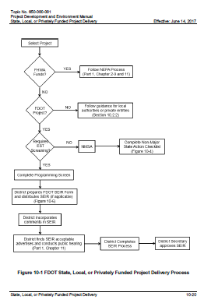
Getting to Construction Sooner in 14 easy steps!
Maximize number of Projects Using State Funds Only
Our Flow Chart to Determine Eligibility

Slide 26
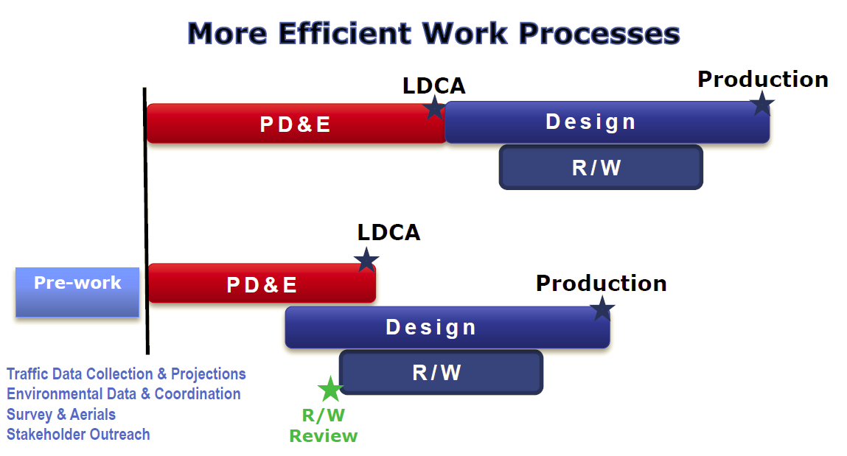
Getting to Construction Sooner
in 14 easy steps!
2. Overlap the PD&E and Design Phases

Slide 27

Getting to Construction Sooner in 14 easy steps!
3. More Contractual Options for PD&E and Final Design
PD&E
PD&E
And
Design
Or PD&E with an optional service for Design
Design

Slide 28


Getting to Construction Sooner in 14 easy steps!
4. Designate a Single Project Manager for Both PD&E and Final Design Phases

Slide 29
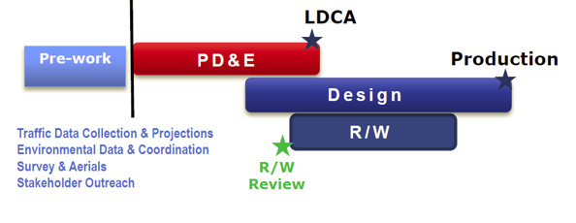
Getting to Construction Sooner in 14 easy steps!
5. Perform Pre-Work In Advance of PD&E Study Commencement

Slide 30
Getting to Construction Sooner in 14 easy steps!
36 to 27 months
6. Streamline the PD&E and Design Schedule Templates

Slide 31

Getting to Construction Sooner in 14 easy steps!
7. Perform a Value Engineering Study on the Right of Way Acquisition Process

Slide 32

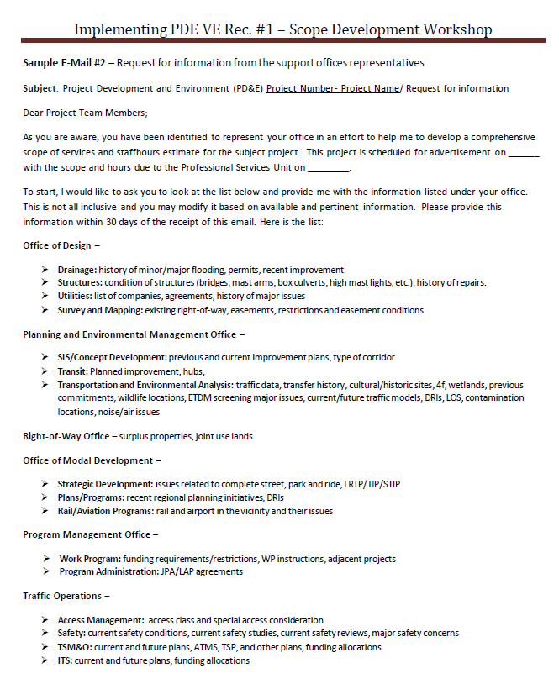
Getting to Construction Sooner in 14 easy steps!
8. Hold Pre-Scoping Meeting Workshops for PD&E Projects

Slide 33
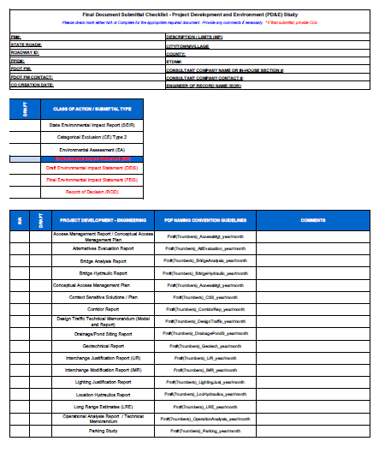

Getting to Construction Sooner in 14 easy steps!
9. Create a PD&E QA/QC Checklist for Final Documents

Slide 34
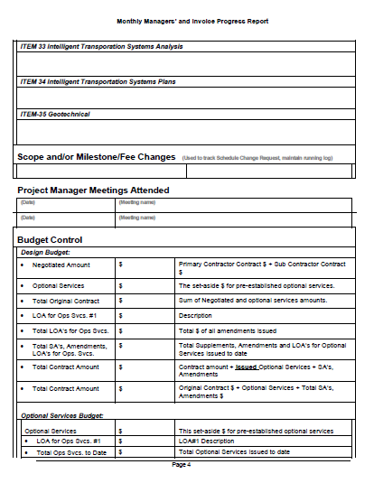
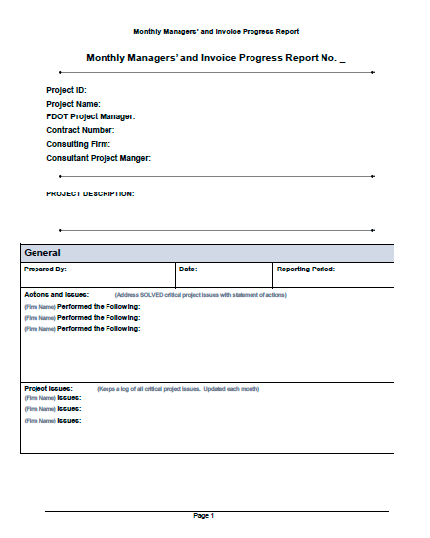
Getting to Construction Sooner in 14 easy steps!
10. Standardize Format for PD&E Project Progress Reports

Slide 35

Getting to Construction Sooner in 14 easy steps!
11. Hold In-Person Regional Training Conferences for FDOT Staff and Consultants

Slide 36
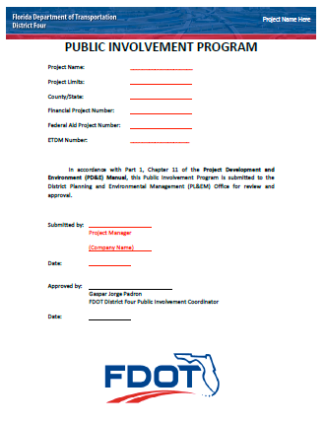
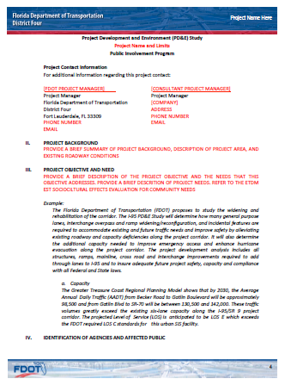
Getting to Construction Sooner in 14 easy steps!
12. Improve the Public Involvement Program (PIP) Template

Slide 37
Getting to Construction Sooner in 14 easy steps!
13. Simplify and Combine PD&E Documents

Slide 38
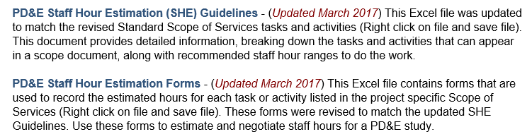
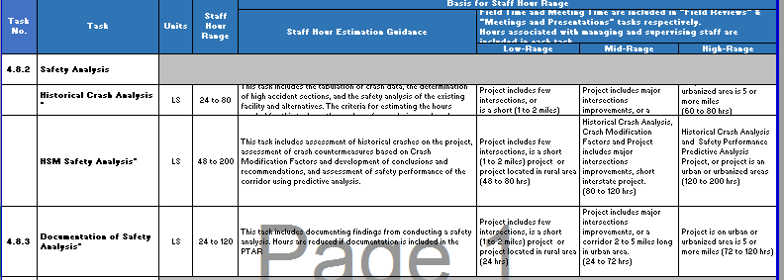
Getting to Construction Sooner in 14 easy steps!
14. Create PD&E Staffing Hour Guideline Spreadsheet and Estimation Form

Slide 39

Summary

Slide 40

Questions?
Please remember to type in your questions to the question prompt.
Thank you for participating!

Slide 41
Presenter Contacts
Kate Kurgan, AASHTO
kkurgan@aashto.org
202-624-3635
David Williams, FHWA
david.Williams@dot.gov
202-366-4074
Dave Huft
South Dakota DOT
Dave.Huft@state.sd.us
575-525-7349
Peggy Laurenz
South Dakota DOT
605.773.3654
peggy.laurenz@state.sd.us
Georgi Celusnek
Florida DOT
Georgi.Celusnek@dot.state.fl.us
954-777-4368

