Slide 1
Expediting Project Delivery Webinar – Improving Project Delivery Outcomes in Documentation and Construction
November 15, 2017
Kate Kurgan, AASHTO
Carlos Figueroa, FHWA
David Williams, FHWA
Michael Smelker, New Mexico DOT
Laura Stone, VTrans

Slide 2




SHRP2 & Its Focus Areas
Safety: Fostering safer driving through analysis of driver, roadway and vehicle factors in crashes, near crashes, and ordinary driving.
Renewal: Rapid maintenance and repair of the deteriorating infrastructure using already-available resources, innovations, and technologies.
Capacity: Planning and designing a highway system that offers minimum disruption and meets the environmental, and economic needs of the community.
Reliability: Reducing congestion and creating more predictable travel times through better operations.

Slide 3
R10 – Project Management Strategies for Complex Projects
Five-dimensional project management approach to identify any issues that should be planned for and managed proactively in the following project elements:
  Cost
  Schedule
  Technical
  Financial
  Context
The planning methods are:
  Define critical project success factors
  Assemble project team
  Select project arrangements
  Prepare early cost model and finance plan
  Develop project action plans

Slide 4
R10 Project Management Tools
Tool 1: Incentivize Critical Project Outcomes
Tool 2: Develop Dispute Resolution Plans
Tool 3: Perform Comprehensive Risk Analysis
Tool 4: Identify Critical Permit Issues
Tool 5: Evaluate Applications of Off-Site Fabrication
Tool 6: Determine Involvement in ROW and Utilities
Tool 7: Determine Work Packages and Sequencing

Slide 5
R10 Project Management Tools (cont.)
Tool 8: Design to Budget
Tool 9: Colocate Team
Tool 10: Establish Flexible Design Criteria
Tool 11: Evaluate Flexible Financing
Tool 12: Develop Finance Expenditure Model
Tool 13: Establish Public Involvement Plans

Slide 6
C19 - Expediting Project Delivery
Expediting Project Delivery identifies 24 strategies for addressing or avoiding 16 common constraints in order to speed delivery of transportation projects.
Strategies Grouped Under Six Objectives:
  Improve internal communication and coordination;
  Streamline decision-making;
  Improve resource agency involvement and collaboration;
  Improve public involvement and support;
  Demonstrate real commitment to the project; and
  Coordinate work across phases of project delivery.

Slide 7
Expediting Project Delivery
Strategy | Stage of Project Planning or Delivery
 | Early Planning | Corridor Planning | NEPA | Design/ROW/ Permitting | Construction
1. Change-control practices |  |  | ● | ● | ●
2. Consolidated decision council |  | ○ | ● | ●
3. Context-sensitive design and solutions | ○ | ○ | ● | ● | ○
4. Coordinated and responsive agency involvement | ○ | ● | ● | ● | ●
5. Dispute-resolution process |  | ○ | ● | ● | ○
6. DOT-funded resource agency liaisons |  | ○ | ● | ●
7. Early commitment of construction funding | ● | ● | ●
8. Expedited internal review and decision-making | ● | ● | ● | ●
9. Facilitation to align expectations up front | ○ | ● | ●
10. Highly responsive public engagement | ● | ● | ● | ● | ○
11. Incentive payments to expedite relocations |  |  |  | ●
12. Media relations manager |  | ● | ● | ● | ○
13. Performance standards | ○ | ● | ● | ●
14. Planning and environmental linkages | ● | ● | ●
15. Planning-level environmental screening criteria | ● | ●
16. Programmatic agreement for Section 106 |  |  | ● | ●
17. Programmatic or batched permitting |  |  | ● | ●
18. Real-time collaborative interagency reviews | ○ | ○ | ● | ○
19. Regional environmental analysis framework | ○ | ● | ● | ●
20. Risk management | ● | ● | ● | ● | ●
21. Strategic oversight and readiness assessment | ○ | ● | ●
22. Team co-location |  | ○ | ● | ●
23. Tiered NEPA process | ○ | ● | ●
24. Up-front environmental commitments |  | ● | ● | ●

Slide 8

SHRP2 on the Web
GoSHRP2
www.fhwa.dot.gov/GoSHRP2
  Apply for Implementation assistance
  Learn how practitioners are using SHRP2 products
SHRP2 @AASHTO http://SHRP2.transportation.org
  Implementation information for AASHTO members
SHRP2 @TRB www.TRB.org/SHRP2
  Research information
FHWA R10 & C19 Websites
https://www.fhwa.dot.gov/GoSHRP2/Solutions/Renewal/R10
https://www.environment.fhwa.dot.gov/strmlng/shrp2-c19/default.asp

Slide 9


AASHTO & FHWA Contacts
David Williams, FHWA
david.Williams@dot.gov
202-366-4074
Carlos Figueroa, FHWA
Carlos.Figueroa@dot.gov
202-366-5266
Kate Kurgan, AASHTO
kkurgan@aashto.org
202-624-3635

Slide 10
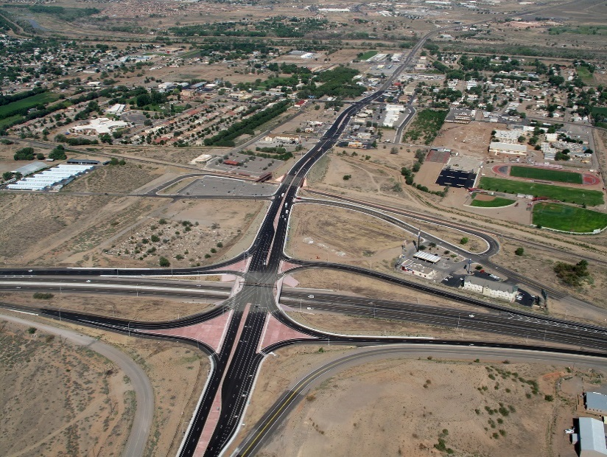


Integrating SHRP2 Into
NMDOT Projects

Slide 11
Benefits of SHRP2?
  Benefits
  Early communication in the process
  Early identification of complexity based on needs of the specific project
  Early preparation of the financials, schedule, and resources
  Looking at context and financing as drivers of the project
  Earlier identification of critical success factors
  Creates a realistic balance between the available funding and scope
  Reduces uncertainties
  Develop project action plans and/or more defined scope report for success

Slide 12

How have other States incorporated SHRP2?
  Round 1 Lead Adopter
  Federal Lands
  Georgia
  Massachusetts
  Michigan
  New Mexico
  Round 4 User
  Alaska, Arizona, Iowa, New Hampshire, North Carolina, Washington, Wisconsin, Rhode Island

Slide 13
Project Definition
  Identify key project issues
  Dimension rank and rating
  Develop complexity map
  Follow-up questions
  Identify critical success factors
  Identify key team members
  Develop preliminary action plan

Slide 14
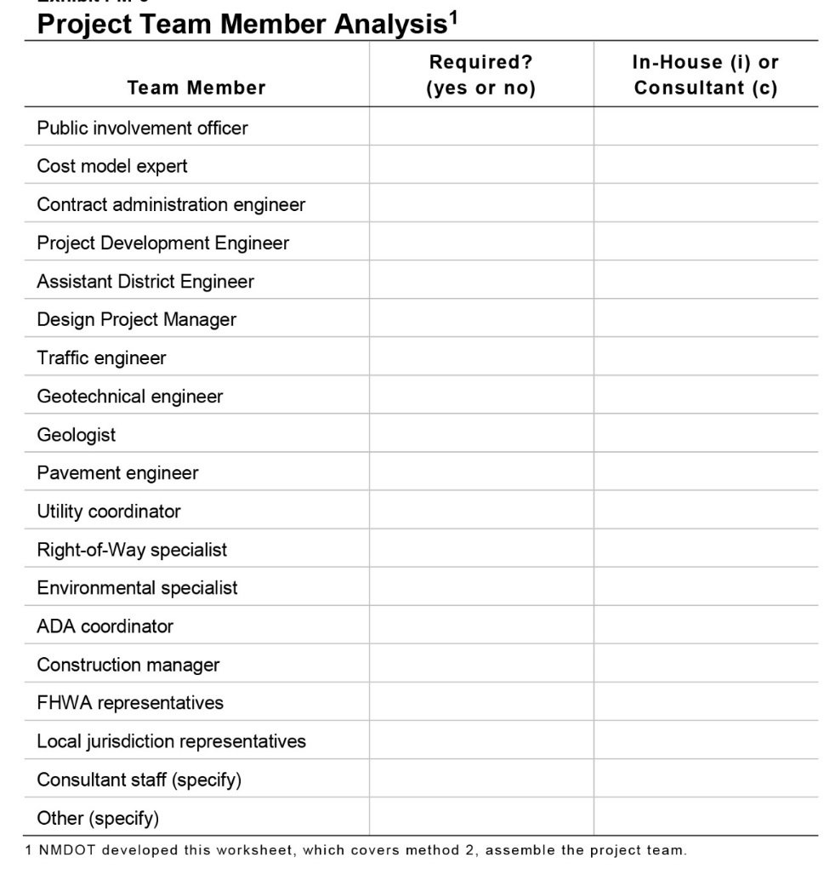
Project Definition – Identify Key Team Members

Slide 15
Project Definition – Identify Key Project Issues
  Cost – Factors that affect cost
  Schedule – Time requirements and constraints to achieve project delivery
  Technical – All technical aspects of a project, including engineering requirements
  Context – External factors that can impact a project
  Financing – How will the project be paid for, including constraints and timing of funding (cash flow)

Slide 16
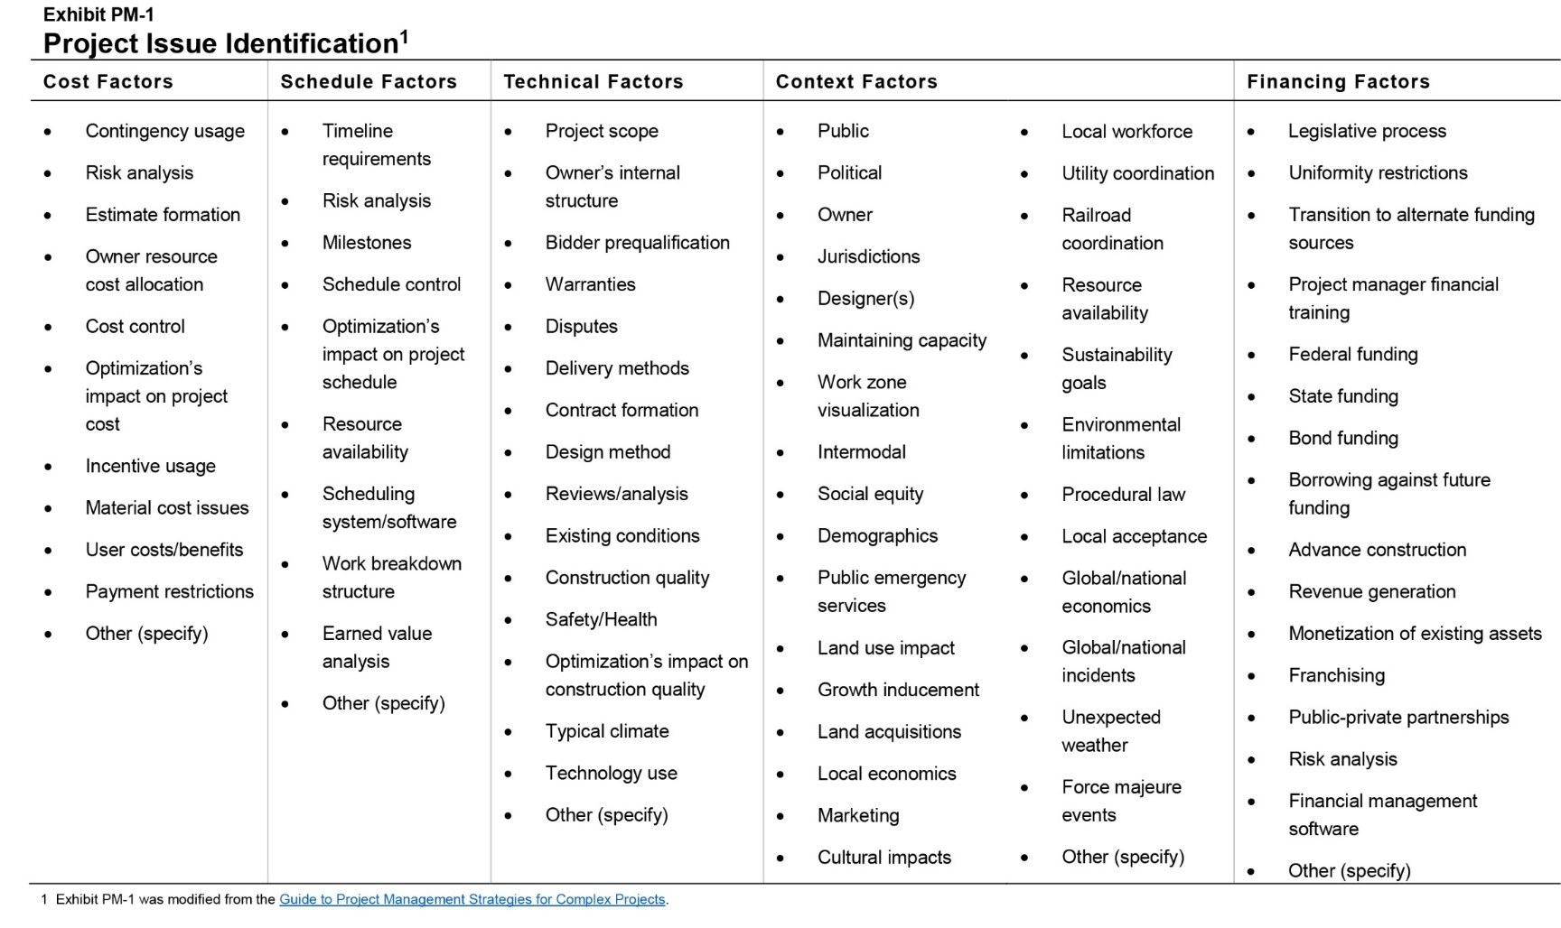
Project Definition – Identify Key Project Issues

Slide 17
Project Definition – Identify Key Project Issues
  Create a statement explaining unique aspects of the project for:
  Cost
  Schedule
  Technical
  Context
  Financing

Slide 18
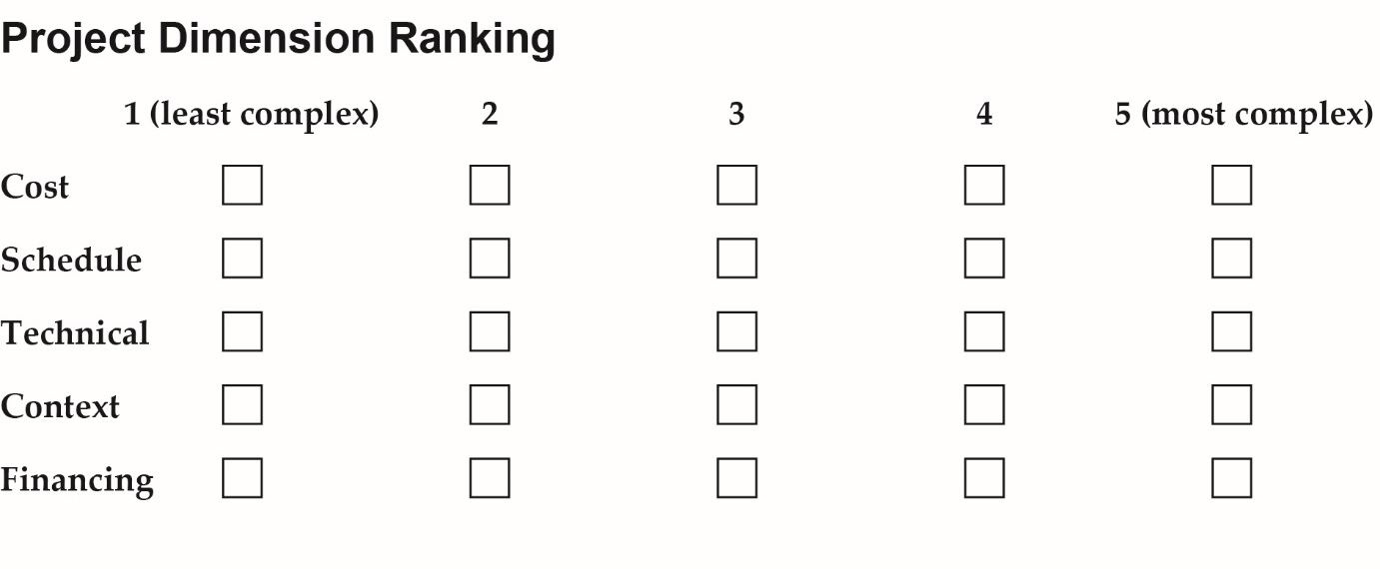
Project Definition – Dimension Ranking

Slide 19
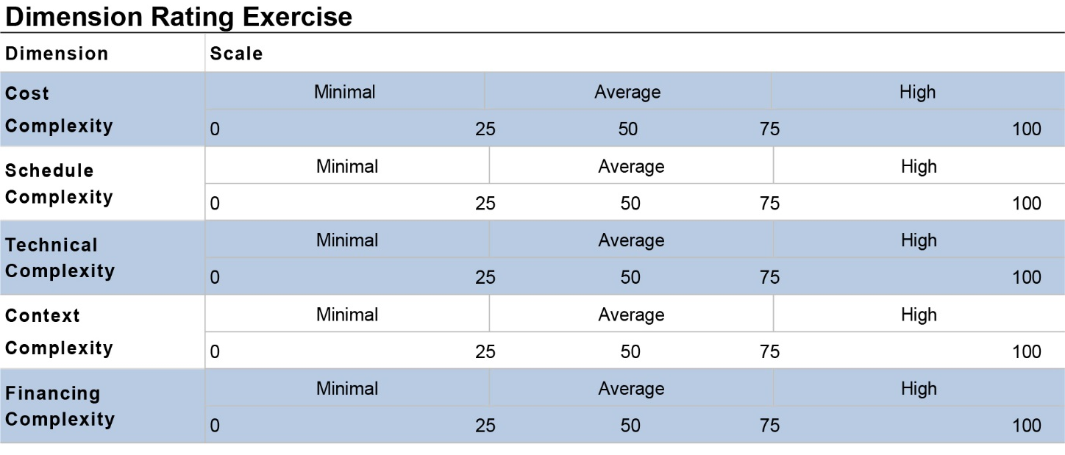
Project Definition – Dimension Rating

Slide 20
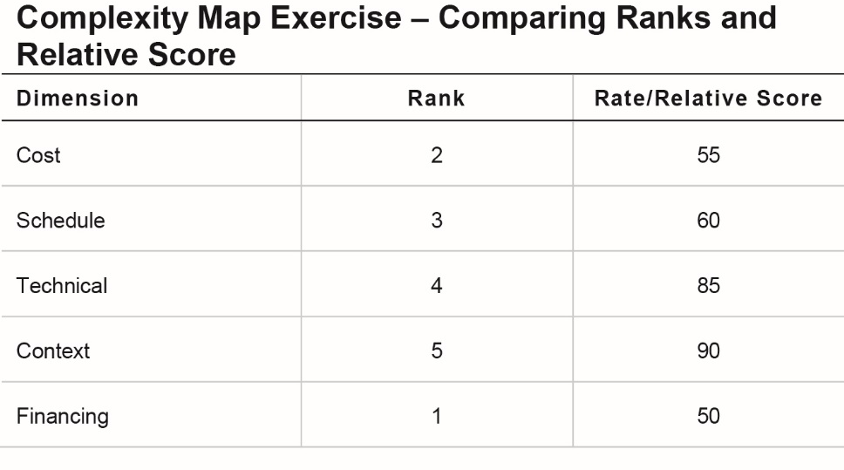
Project Definition – Compare Ranks and Rating

Slide 21
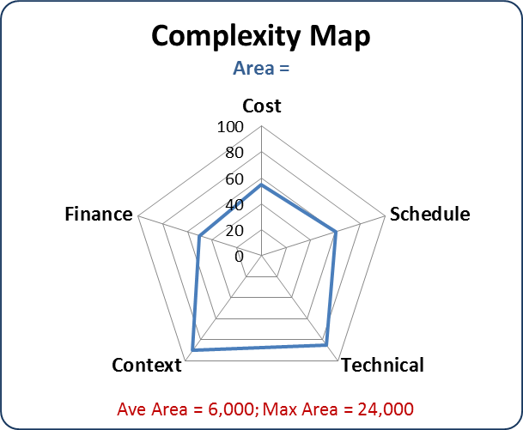
Project Definition – Develop Complexity Map

Slide 22
Project Definition – Tools/Solutions
Incentivize project outcomes
Develop dispute resolution plans
Perform risk analysis
Identify critical permit issues
Special environmental reports
Evaluate off-site fabrication
Determine involvement of right-of-way and utilities
Design to budget
Co-locate team
Establish flexible design criteria
Evaluate flexible financing
Develop finance expenditure model
Establish public involvement plans

Slide 23
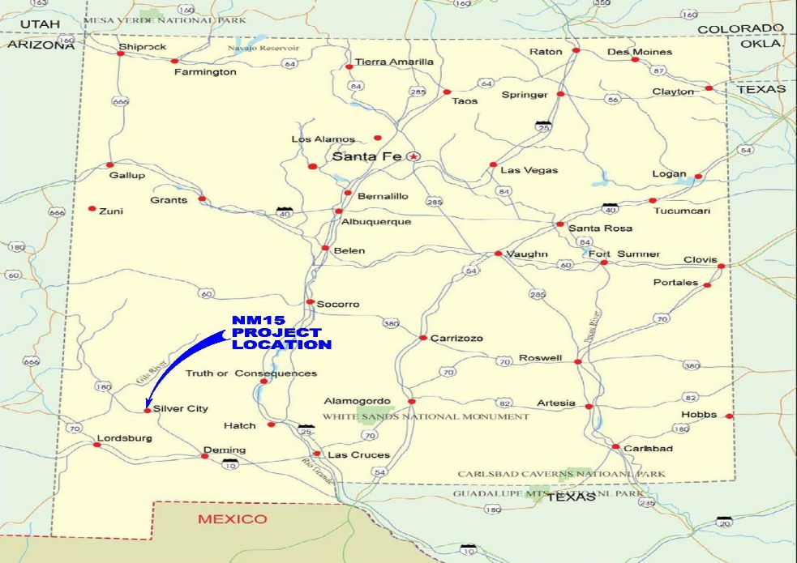
Regional Map
Santa Fe, NM
NM 15 Project Location
Silver City , NM

Slide 24
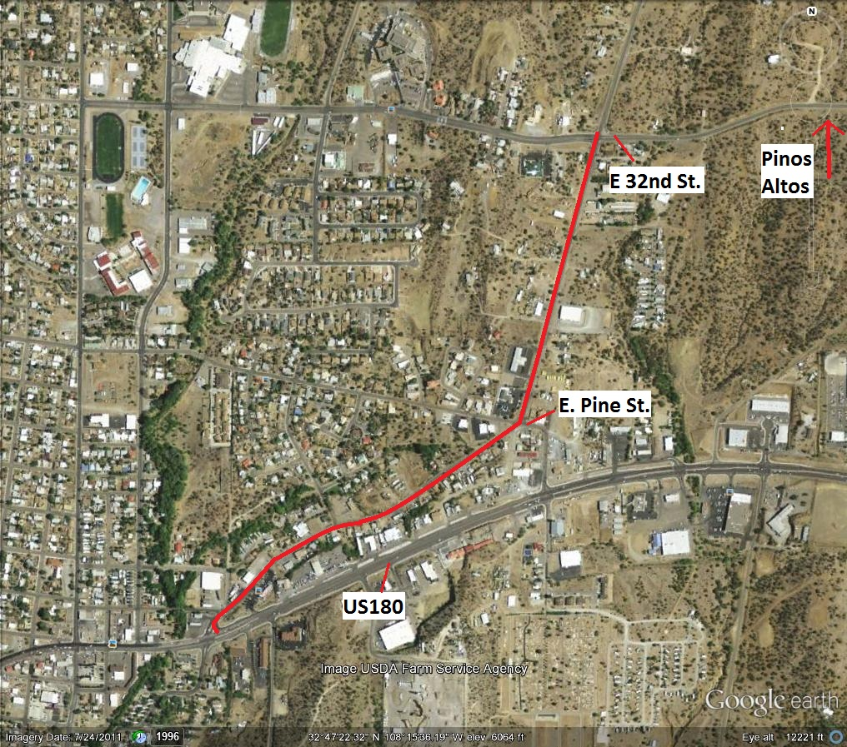

Vicinity Map
NM 15 End of Project
Silver City , NM
NM 15 Beginning of Project

Slide 25
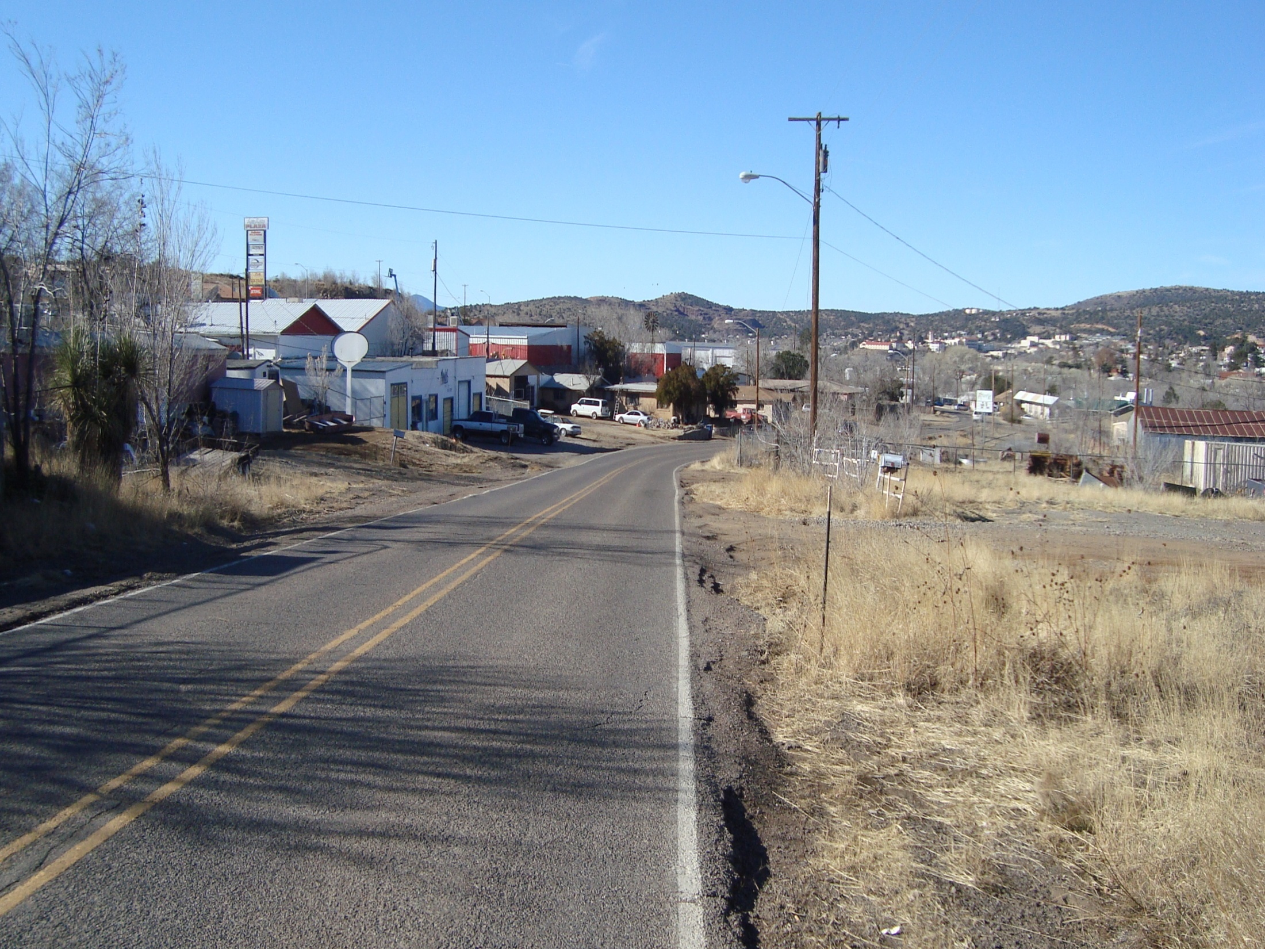
Funding of the Project
Funding $8 million
Consists of construction, ROW,
design/engineering, stipends,
and construction management
Risk in Cost
  Rock Excavation
  Lighting
  Urban Design

Slide 26
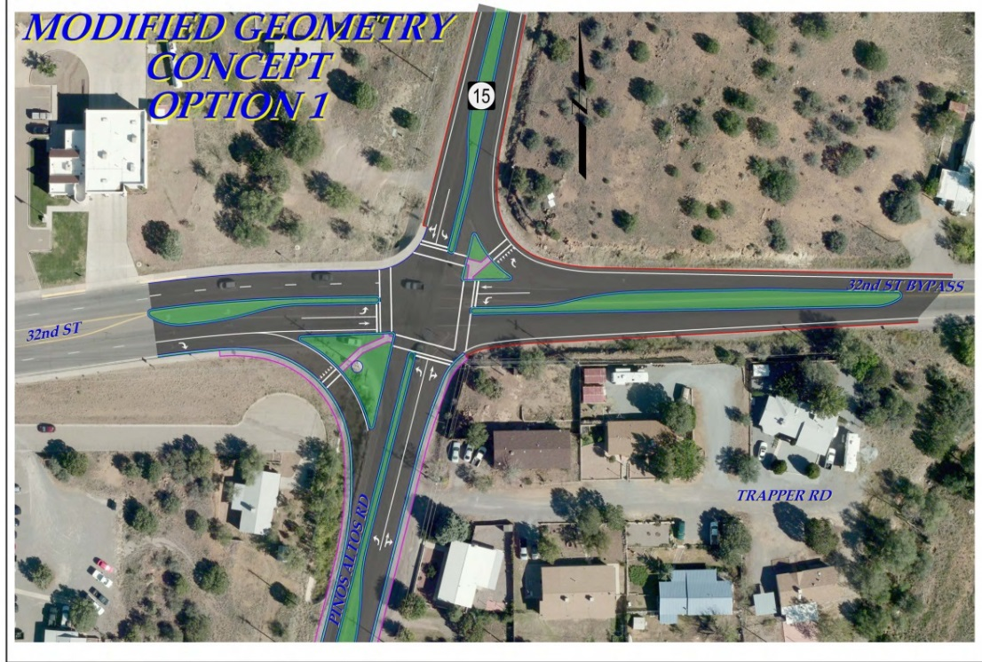
Schedule
Schedule
Environmental Process
Right of Way
Property Surveys
Utility Relocations

Slide 27
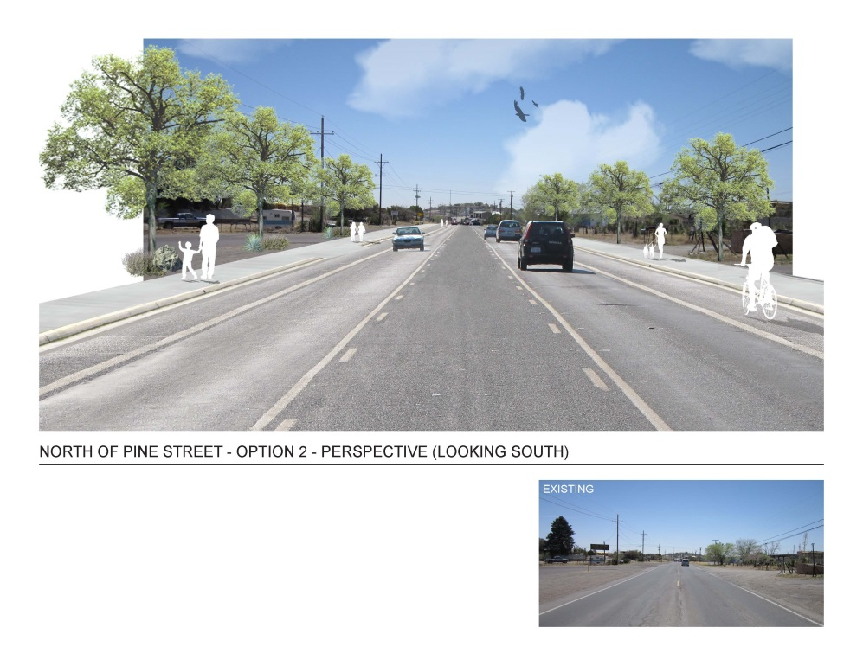
Technical
Technical
American with Disabilities Act
Driveways
Urban Section
Limited Right of Way
Maintenance of Traffic Control
Public Involvement

Slide 28
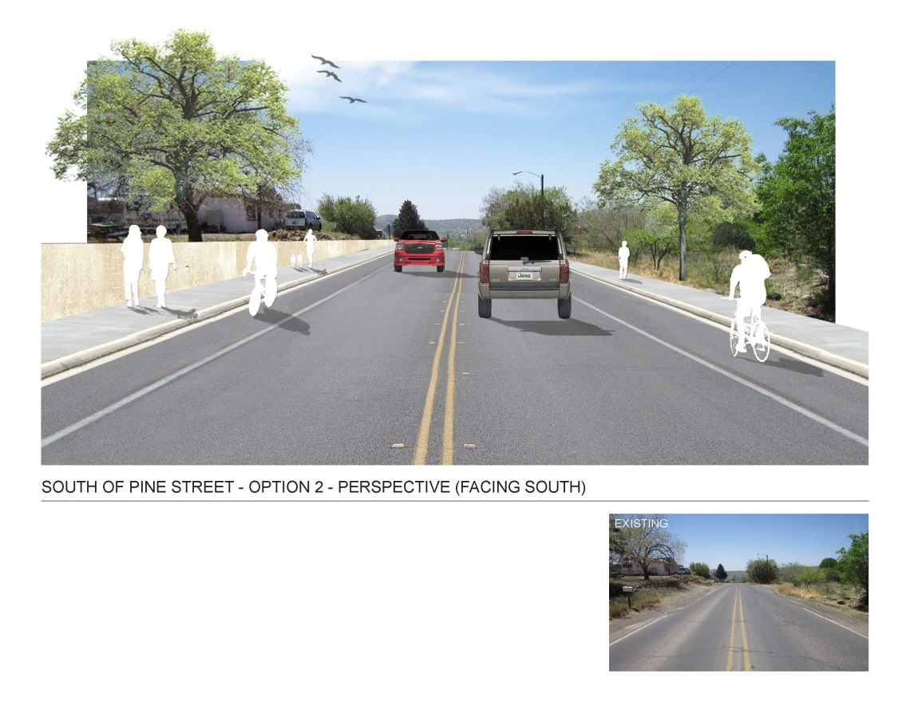
Context
Cycling Community
Steep Slopes
Utility Relocation
Lighting Agreements

Slide 29
Financing
Financing
State and Federal aid – highway funds
Town of Silver City lack of necessary financing for lighting and utility relocations.

Slide 30
How has NMDOT incorporated SHRP2 to date?
  NM 15 Silver City Project
  Cost – Determined risk in cost was rock excavation, lighting, urban design.
  Schedule – Determined that right of way and utility relocation will affect schedule.
  Financing – Town of Silver City lacks necessary funds for lighting and utility relocations.
  Context – Cycling community, steep slopes, utility relocation, public involvement
  Technical – ADA, urban section, limited right of way
  Note: This project’s estimate is about $8 million.

Slide 31
How is NMDOT integrating SHRP2?
  Integrating specific aspects of SHRP2 that will apply to most NMDOT projects
  Most of the work will occur during project definition
  Pavement preservation projects will not be required to complete the SHRP2 elements that have been integrated into project development
  Other NMDOT projects, including rehabilitation, reconstruction, new construction, and all consultant-led projects will require SHRP2 documentation

Slide 32
How is NMDOT integrating SHRP2?
  Updating our project development process
    Project Definition
      Determine project complexities
      Identify project challenges and success factors
      Identify key team members
      Develop a preliminary action plan
    Project Scoping and Conceptual Design
      Update complexity map
      Update the project action plan
      Optional exercises to help with cost and financing issues
    Preliminary Design
      Update complexity map
      Update the project action plan
      Optional exercises to help with cost and financing issues

Slide 33
Project Definition – Complexity Map Follow-up Questions
  How are you going to address your most complex dimension?
  What resource allocation issues need to be addressed as part of project planning for each dimension?
  When are you going to address these complexity factors?

Slide 34
Project Definition – RFP vs. Internal Design Projects
    For projects involving RFP development for consultants, this up front work should help form the basis of the consultant RFP.
      Consultants have indicated that the preliminary action plan and complexity map would be helpful for them to see in an RFP
      The goal would be to improve the RFP process for both NMDOT and consultants.
    For internal design projects, this upfront work will help to develop a solid scope of work. The intent of the work is to minimize scope creep as the project progresses.
    Documentation becomes part of the project file.

Slide 35
Lesson Learned
Small Project
Currently utilizing most of the items in daily design development process.
Small complex project – IT WORKS TO GET THE COMMUNICATION ON THE PROJECT STARTED.
Method works great on design build projects.
Great Process for Young Project Development Engineers

Slide 36
SHRP2 C19 Expediting Project Delivery – VTrans Accelerated Bridge Program
Expediting Project Delivery Webinar – Improving Project Delivery Outcomes in Documentation and Construction
November 15, 2017
Laura J. Stone, PE
VTrans

Slide 37
Accelerated Bridge Program
(ABP)
ABP Created in 2012
Reorganized into two new sections
  Accelerated Bridge Program (ABP)
  Project Initiation and Innovation Team (PIIT)
Structures Program
Accelerated Bridge Program
Bridge Preservation
Alternative Contracting
Conventional Project Design/Delivery
Project Initiation & Innovation Team (PIIT)

Slide 38
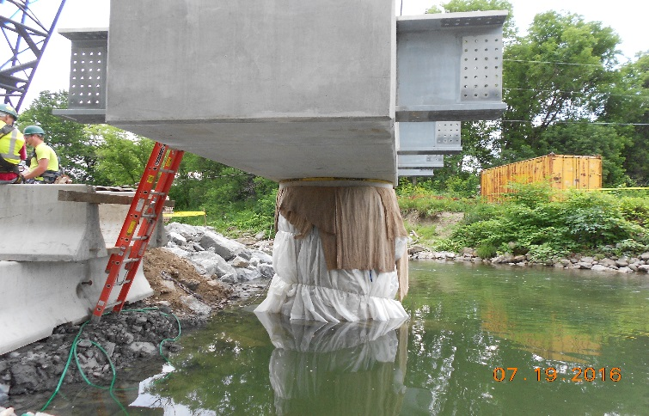
Accelerated Bridge Program
(ABP)
Programmatic approach to accelerating projects
Project Delivery 24 months from Project Defined to Bid Advertisement
Programmatic use of ABC
Initial goal of 25% of
all bridge projects

Slide 39
ABP Implementation
Early Project Coordination
  Public outreach
  Contractor Input
  Internal and External Stakeholders
Streamline/expedite the project delivery process
  Maximize flexibility in rules and process
  Evaluate risk but run concurrent activities
Develop and use standard details for ABC
Design projects to be successful for ABC

Slide 40
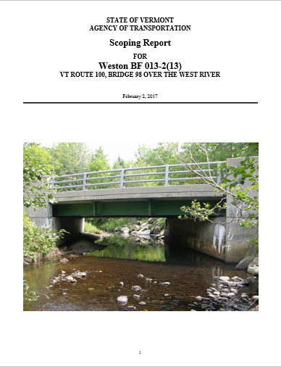
Project Initiation & Innovation Team
(PIIT)
Dedicated team of scoping Engineers
and Technicians
All bridge projects start here
Approximately 20-30 projects
initiated and scoped per year
Heavy emphasis on collaboration
Public Engagement in Process
ABC option is always first consideration.

Slide 41

SHRP2 C19
Leveraging Strategies to Remove Impediments
and Deliver Projects

Slide 42
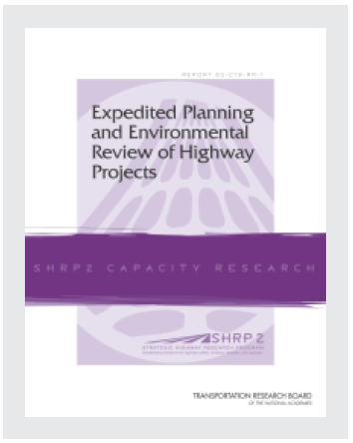
SHRP2 C19
In 2012, SHRP2 published a report entitled, “Expedited Planning and Environmental Review of Highway Projects.”
  16 Constraints
  24 Strategies

Slide 43
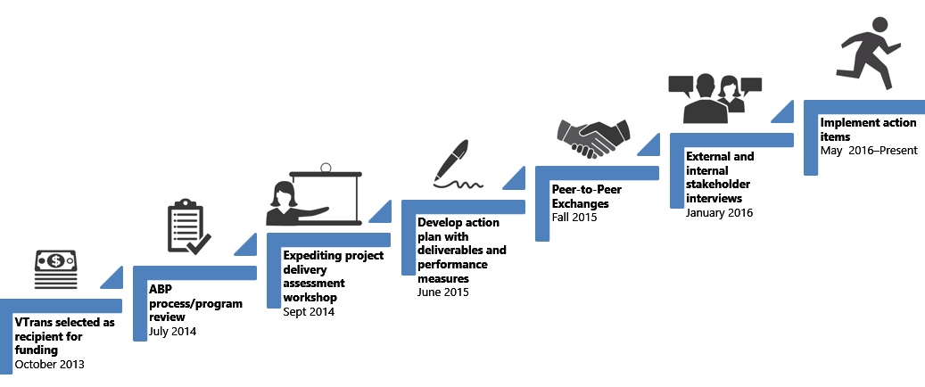
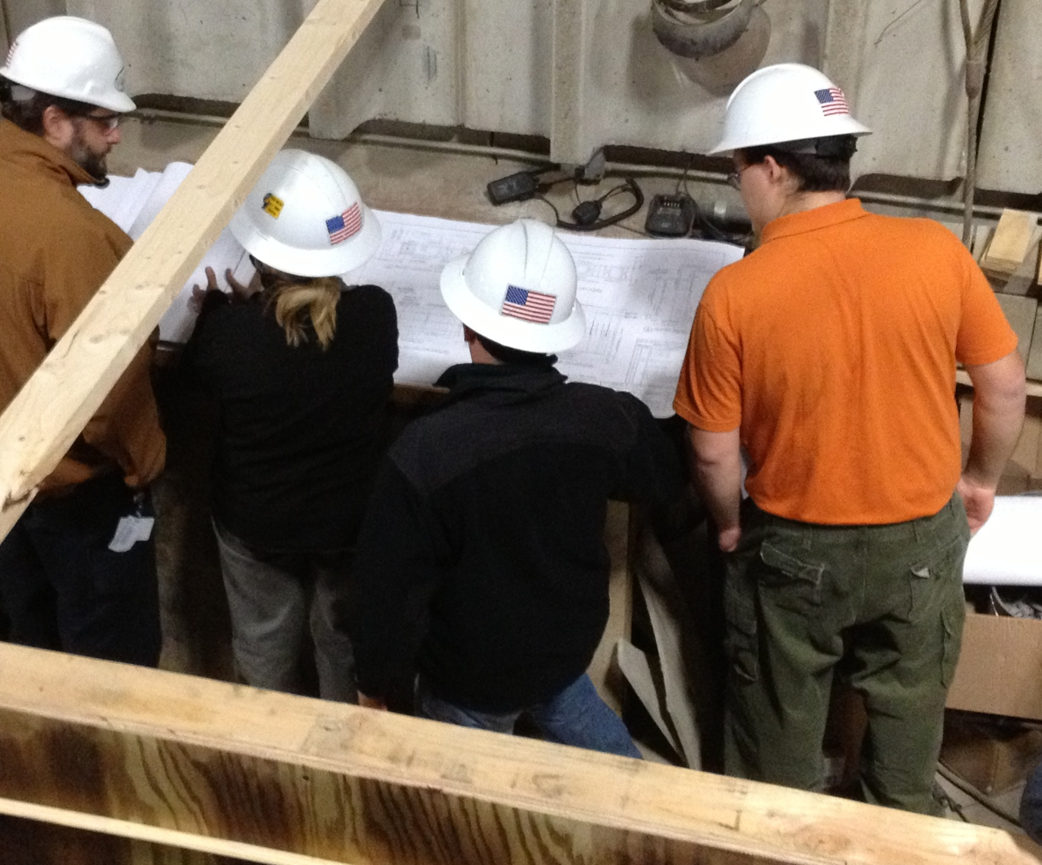
SHRP2 C19
In October 2013, VTrans was selected as a Lead Adopter of SHRP2 C19.
Program Assessment of Project Delivery
  Leadership
  Data management
  Scoping
  Design
  Resources
  Public Outreach
Development of Action Plan
Implementation of Action Items
Final Report of Experience

Slide 44
5 Key Strategies for Expediting Project Delivery
Strategy 3: Context Sensitive Design/Solutions
Strategy 8: Expediting Internal Review and Decision Making
Strategy 10: Highly Responsive Public Engagement
Strategy 21: Strategic Oversight and Readiness Assessment
Strategy 22: Team Co-Location

Slide 45
C19 Desired Outcomes
Evaluate risks to timely project delivery
Identify opportunities to expediting projects with special emphasis on the strategies described in the Expediting Project Delivery report
Identify resource demands for the ABP and how this may differ from conventional project delivery
Analyze the VTrans organizational structure for opportunities for increased efficiencies
Identify potential process improvements
Build relationships with internal and external partners

Slide 46
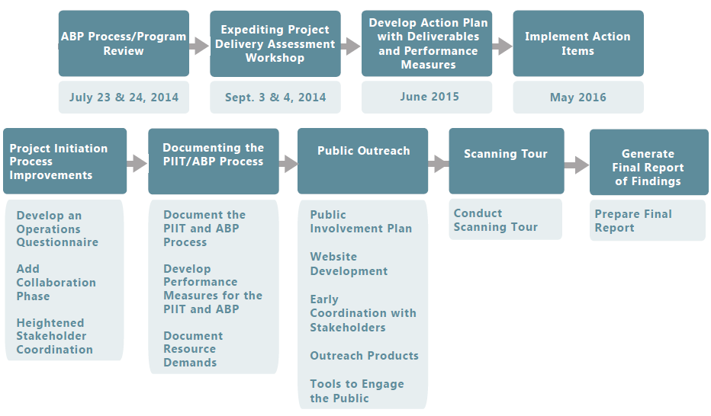
C19 Action Plan Drawing Upon
Key Strategies

Slide 47
Strategy 3: Context Sensitive
Design Solutions
Objective: Improve public involvement and support
Enhanced project scoping in the PIIT
Community and Operations Questionnaires
Addition of “Collaboration Phase” during project definition
Proper Selection of selected alternatives (avoidance, minimization, and mitigation)

Slide 48
Strategy 8: Expediting Internal Review and Decision Making
Objective: Streamline decision making
Batching of scoping projects for resource ID
Heightened Communication and Collaboration
  Collaboration Phase During Project Definition
  Team Meetings
  Constructability Review Meetings
  Pre-closure Contractor Meeting
Concurrent Activities and Decision Tree

Slide 49
Strategy 10: Highly Responsive Public Engagement
Objective: Improve public involvement and support
Providing Financial Incentives on TH Projects (ACT 153)
Public Meetings throughout the life of the project
Effective Public Engagement
  Audience Response Systems
Public Involvement Plans
Project Outreach Coordinators
Customer Satisfaction Surveys

Slide 50
Strategy 21: Strategic Oversight and Readiness Assessment
Objective: Improve internal communication and coordination
Creating a Culture that Values Innovation
Strong and Effective Project Management
Developing Key Planning Documents
  Traffic Management Plans
  Public Involvement Plans
  Risk Registry
  Credible Schedules and Spending Profiles
Standardized Design Details

Slide 51
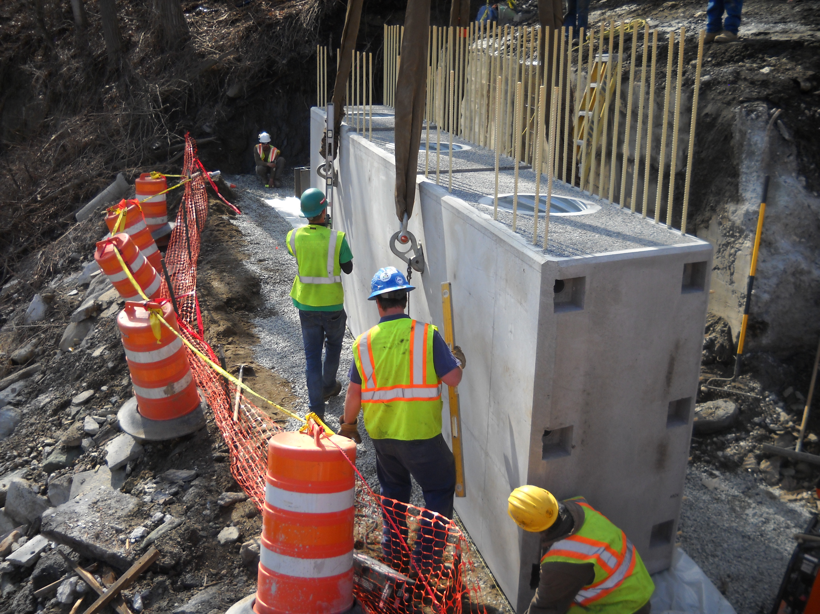
Strategy 22: Team
Co-Location
Objective: Improve internal communication and coordination
Resource Groups Housed Together
Dedicated Utility Relocation Specialists
Project Development Team Meetings
Constructability Review Meetings

Slide 52
C19 Peer Exchanges
Peer Exchanges with MassDOT, NYSDOT and MaineDOT
  Project teams from VTrans in Attendance
  Program Overviews
  Accelerated Program Emphasis Areas
  Shared New Initiatives, Innovations, and Lessons Learned
Numerous Takeaways from the Program/Process Review, Peer to Peer Exchanges, and Stakeholder Interviews

Slide 53
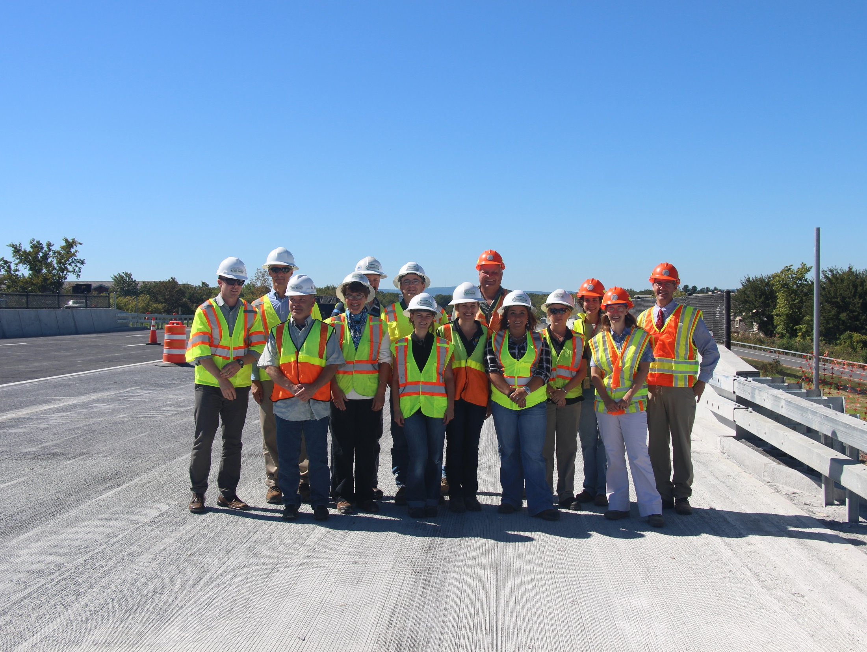
Peer to Peer Exchanges
NYS DOT
September 22 and 23, 2015

Slide 54
Our C19 Journey Has Just
Begun
Explore Enhancements in the PIIT process
  Leverage expertise in VTrans to help refine recommended alternatives
  Develop truncated scoping report for Preventative Maintenance and Emergency Projects
  Explore effective methods to engage upper lever management on high risk and high cost projects
  Develop prescreening GIS tool for resource ID

Slide 55

ABC Performance
54 ABC projects
Delivered from 2012 to date, which is
50% of all Projects
Representing
$84 Million
Construction costs
100%
New Bridges Opened on Time

Slide 56
ABP –Engineering Costs
40% savings in Engineering costs
  ABC Standardized approach
  Shorter duration design process = Preliminary Engineering (PE) Savings
  ABC = Shorter Construction Durations and Construction Engineering (CE) Savings

Slide 57
ABP –Resource Demands
70-75% savings in resource demands
  ABC = Less impact to existing Utilities
  ABC = Less ROW impacts
  ABC = Less Environmental impacts
  Team Co-organization and Co-location efficiencies

Slide 58
ABC Construction Savings
18% Savings
ABC vs Conventional Projects based on 37 new projects

Slide 59
Customer Survey Results
How satisfied were you with ABC?
  397 Responses from 9 2015 projects
How satisfied are you with the information you received about the bridge project?
Overall, how satisfied were you with how VTrans delivered this project?

Slide 60
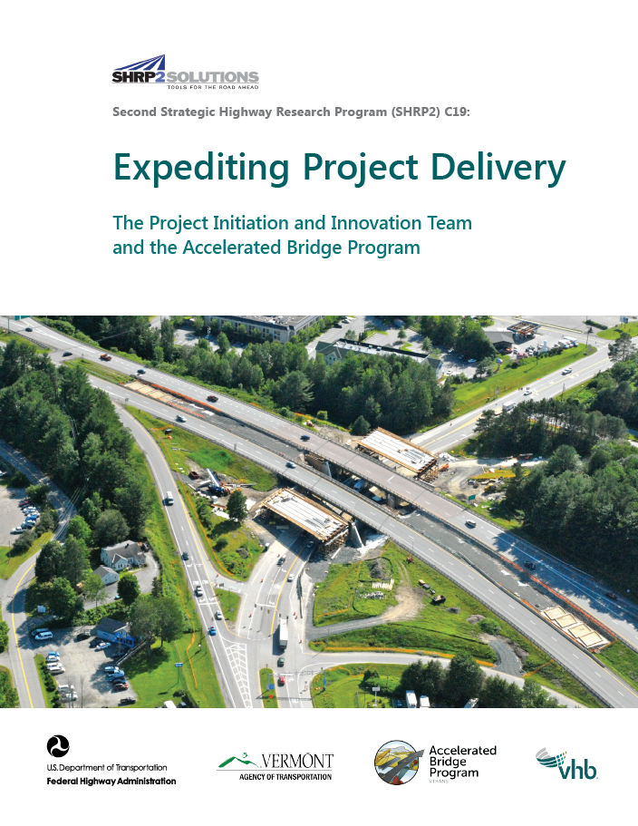
Want to Know More…
Final Report Completed in September 2017
    http://vtrans.vermont.gov/sites/aot/files/portal/documents/other/SHRP2%20C19%20Final%20Report%20-%20Expediting%20Project%20Delivery.pdf
VTrans Public Involvement Guide
    http://vtrans.vermont.gov/sites/aot/files/highway/documents/publications/VTransPublicInvolvementGuide2017.pdf
Project Case Study Sheet
Contact Us

Slide 61
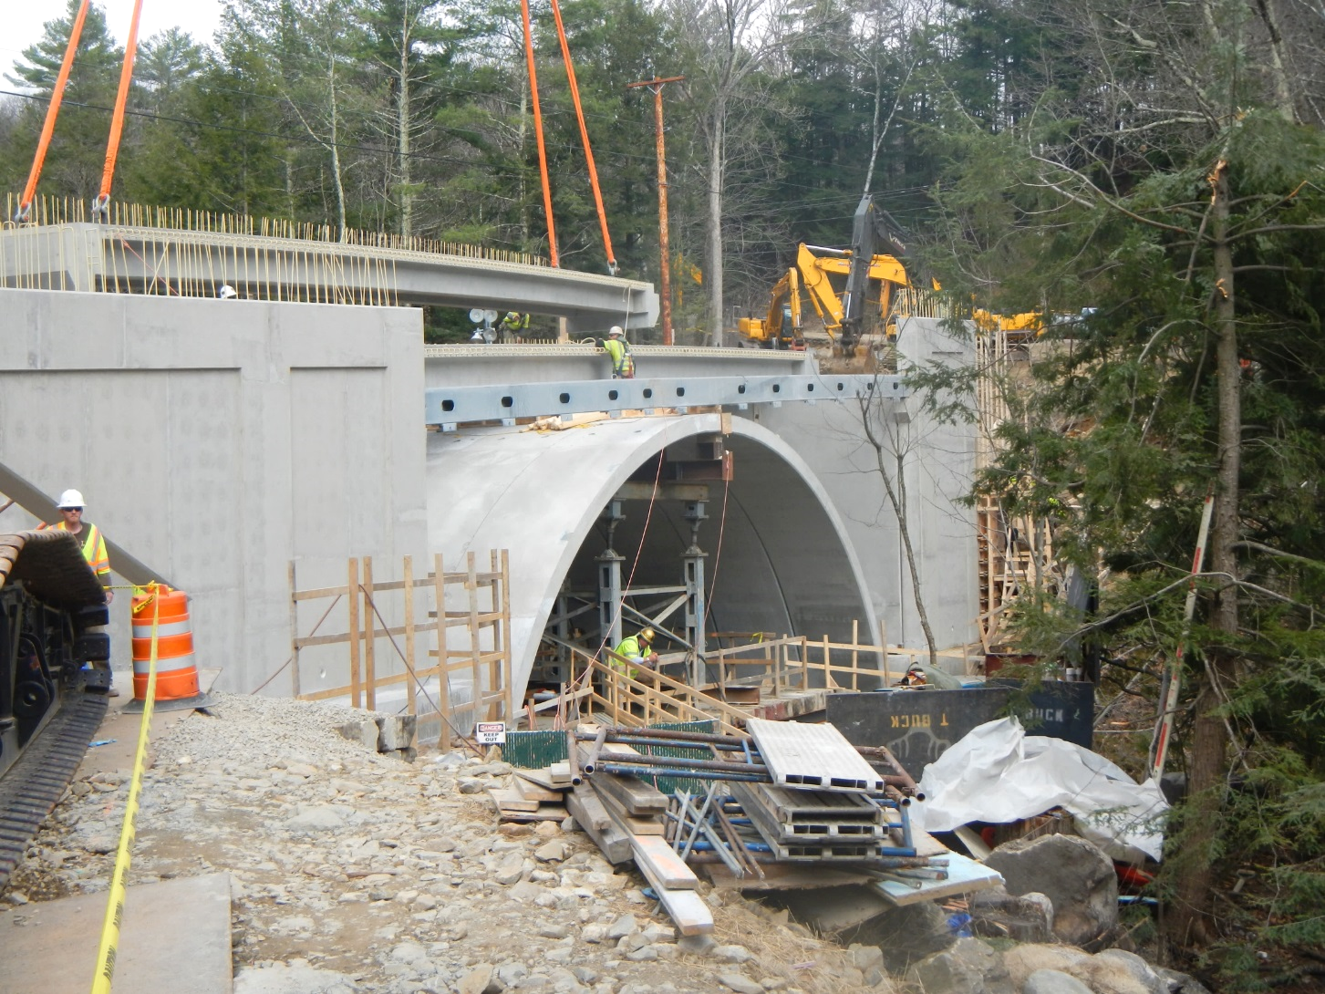
Thank You

Slide 62

Questions?
Please remember to type in your questions to the question prompt.
Thank you for participating!

Slide 63
Presenter Contacts
Kate Kurgan, AASHTO
kkurgan@aashto.org
202-624-3635
Carlos Figueroa, FHWA
Carlos.Figueroa@dot.gov
202-366-5266
David Williams, FHWA
david.Williams@dot.gov
202-366-4074
Michael Smelker
New Mexico DOT
MichaelJ.Smelker@state.nm.us
575-525-7349
Laura Stone, VTrans
Laura.Stone@vermont.gov
802-828-3042

