Slide 1
Expediting Project Delivery Webinar - Streamlining Decision Making in Project Delivery
Kate Kurgan, AASHTO
David Williams, FHWA
Jacque Annarino & Tim Hill, Ohio DOT
Denise McClafferty & Jami Dennis, Maricopa Association of
Governments
March 23, 2016

Slide 2




SHRP2 & Its Focus Areas
Safety: Fostering safer driving through analysis of driver, roadway and vehicle factors in crashes, near crashes, and ordinary driving.
Renewal: Rapid maintenance and repair of the deteriorating infrastructure using already-available resources, innovations, and technologies.
Capacity: Planning and designing a highway system that offers minimum disruption and meets the environmental, and economic needs of the community.
Reliability: Reducing congestion and creating more predictable travel times through better operations.

Slide 3
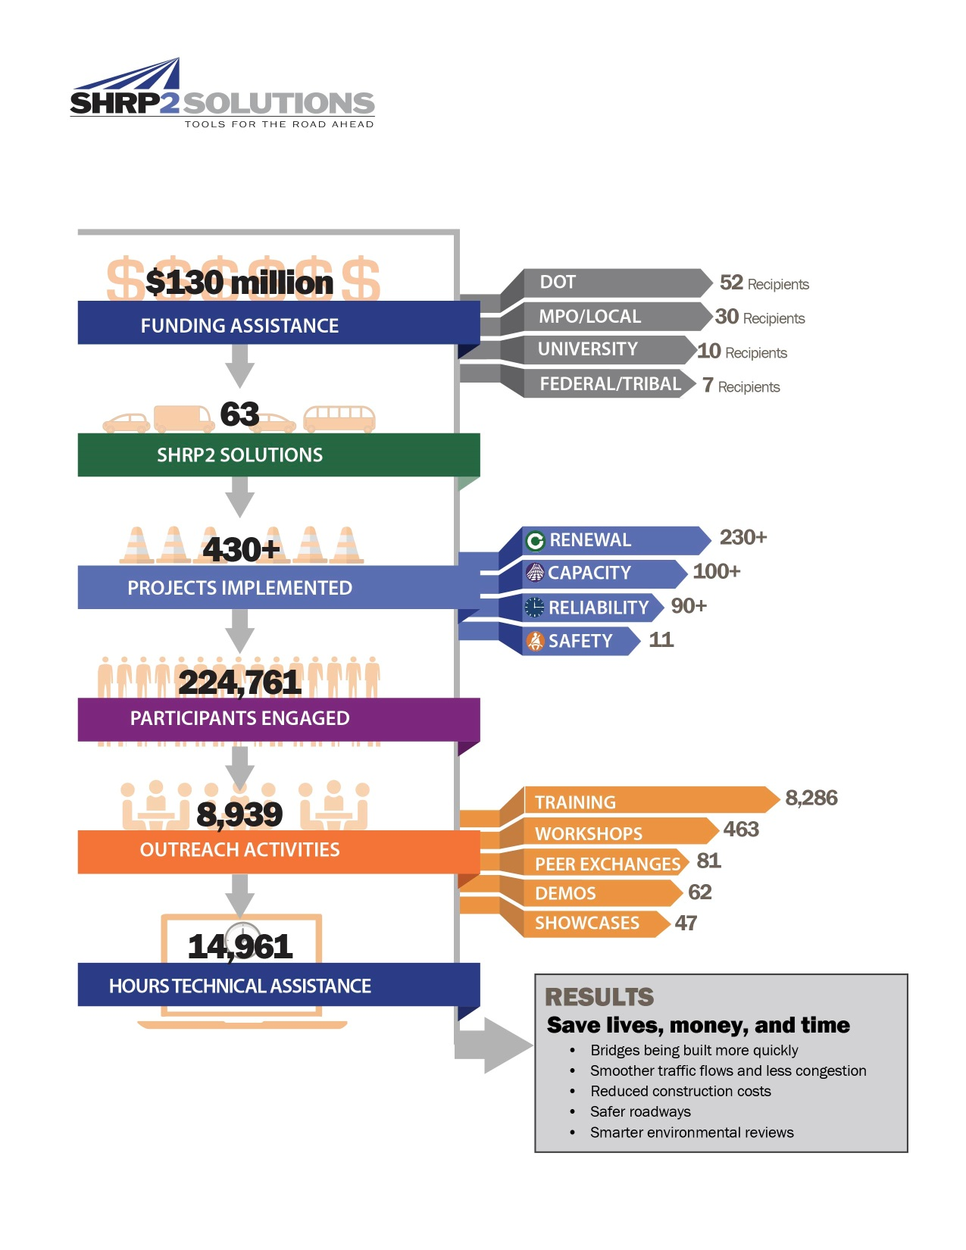
SHRP2 Implementation:
INNOVATE.IMPLEMENT.IMPROVE.
Notes:
3

Slide 4
SHRP2 Implementation:
INNOVATE.IMPLEMENT.IMPROVE.
Notes:
4

Slide 5

SHRP2 at a Glance
SHRP2 Solutions – 63 products
Solution Development – processes, software, testing procedures, and specifications
Field Testing – refined in the field
Implementation – 430+
transportation projects; adopt as
standard practice
SHRP2 Education Connection –
connecting next-generation
professionals with next-generation
innovations
430+
SHRP2 projects nationwide
13 agencies were selected to implement C19 strategies.

Slide 6
Expediting Project Delivery
Expediting Project Delivery identifies 24 strategies for addressing or avoiding 16 common constraints in order to speed delivery of transportation projects.
Strategies Grouped Under Six Objectives:
  Improve internal communication and coordination;
  Streamline decision-making;
  Improve resource agency involvement and collaboration;
  Improve public involvement and support;
  Demonstrate real commitment to the project; and
  Coordinate work across phases of project delivery.

Slide 7
Expediting Project Delivery
Strategy | Stage of Project Planning or Delivery
 | Early Planning | Corridor Planning | NEPA | Design/ROW/ Permitting | Construction
1. Change-control practices |  |  | ● | ● | ●
2. Consolidated decision council |  | ○ | ● | ●
3. Context-sensitive design and solutions | ○ | ○ | ● | ● | ○
4. Coordinated and responsive agency involvement | ○ | ● | ● | ● | ●
5. Dispute-resolution process |  | ○ | ● | ● | ○
6. DOT-funded resource agency liaisons |  | ○ | ● | ●
7. Early commitment of construction funding | ● | ● | ●
8. Expedited internal review and decision-making | ● | ● | ● | ●
9. Facilitation to align expectations up front | ○ | ● | ●
10. Highly responsive public engagement | ● | ● | ● | ● | ○
11. Incentive payments to expedite relocations |  |  |  | ●
12. Media relations manager |  | ● | ● | ● | ○
13. Performance standards | ○ | ● | ● | ●
14. Planning and environmental linkages | ● | ● | ●
15. Planning-level environmental screening criteria | ● | ●
16. Programmatic agreement for Section 106 |  |  | ● | ●
17. Programmatic or batched permitting |  |  | ● | ●
18. Real-time collaborative interagency reviews | ○ | ○ | ● | ○
19. Regional environmental analysis framework | ○ | ● | ● | ●
20. Risk management | ● | ● | ● | ● | ●
21. Strategic oversight and readiness assessment | ○ | ● | ●
22. Team co-location |  | ○ | ● | ●
23. Tiered NEPA process | ○ | ● | ●
24. Up-front environmental commitments |  | ● | ● | ●

Slide 8
Implementation Award
Recipients
Arizona Department of Transportation (ADOT)
Arkansas State Highway and Transportation Department (AHTD)
Association of Monterey Bay Area Governments (AMBAG)
California Department of Transportation (Caltrans)
Florida Department of Transportation (FDOT)
Idaho Transportation Department (ITD)
Maricopa Association of Governments (MAG)
Massachusetts Department of Transportation (MassDOT)
Nebraska Department of Roads (NDOR)
South Carolina Department of Transportation (SCDOT)
South Dakota Department of Transportation (SDDOT)
Vermont Agency of Transportation (VTrans)

Slide 9


AASHTO & FHWA Contacts
Kate Kurgan, AASHTO
kkurgan@aashto.org
202-624-3635
David Williams, FHWA
david.Williams@dot.gov
202-366-4074

Slide 10

SHRP2 on the Web
GoSHRP2
www.fhwa.dot.gov/GoSHRP2
  Apply for Implementation assistance
  Learn how practitioners are using SHRP2 products
SHRP2 @AASHTO http://SHRP2.transportation.org
  Implementation information for AASHTO members
SHRP2 @TRB www.TRB.org/SHRP2
  Research information
FHWA C19 Website
https://www.environment.fhwa.dot.gov/env_initiatives/SHRP2.aspx

Slide 11

Streamlining With
NEPA Assignment at ODOT
March 2017
Office of Environmental Services
Tim Hill, Administrator
Jacque Annarino, NEPA Assignment Coordinator

Slide 12
Streamlining at ODOT
ODOT’s need to integrate and streamline
How ODOT changed approach to project development
Accomplishments and Benefits of new approach

Slide 13

Why the need to Integrate and Streamline?

Slide 14
ODOT’s Approach to Project Development
Project Development Process
Consultant Scoping Fees Guidance
Online Environmental Documentation System (EnviroNet)

Slide 15
ODOT’s Approach to Project Development
Programmatic Agreements
Future Programmatic Agreements
Farmlands
Coastal
Ecological
Indiana & Northern Long-Eared Bat
Cultural Resources
Categorical Exclusion (CE)
  Scenic River
  Section 6(f)
  Section 4(f)
  Environmental Justice (guidance approved by FHWA- similar to an MOA)
Emergency Projects
  Endangered Species

Slide 16
NEPA Assignment Potential Benefits for Ohio
Estimated 20-25% time savings to program
Estimated savings of up to $23 million annually
  Reduced project inflation
  Project user delay costs
Low risk - maybe 1 lawsuit every 8-10 years

Slide 17
Potential Streamlining Opportunities with NEPA Assignment
For projects under $20 million
FHWA reviews 4(f) and other support documents = 15-30 days
40 per year = 1,000 review days per year
35% performed concurrently = 650 project review days
Out of the 650, only 15% result in critical path reviews = 98 days
3.9% inflation and delay cost = $500,000 per year

Slide 18
Potential Streamlining Opportunities with NEPA Assignment
For projects $20 million to $149 million
FHWA performs reviews on:
  Purpose and Need = 30 days
  Feasibility Study = 30 days
  Alternative Evaluation Report = 30 days
  Section 4(f) actions = 45 days
  Review and approval of the CE = 60 days
  …plus multiple reviews (drafts, etc.)

Slide 19
Potential Streamlining Opportunities with NEPA Assignment
For projects $20 million to $149 million
FHWA review for a medium sized project- 390 days
30% performed concurrently = 273 project review days
ODOT averages 12 projects per year = 3,276 review days
Out of this, 25% results in critical path reviews
= 819 days of delay
3.9% inflation and delay cost = $5.7 million per year
User costs/crash reduction benefits = $13.2 million per year

Slide 20

Potential Streamlining Opportunities with NEPA Assignment
For biggest projects…

Slide 21

ODOT’s New Approach to Project Development
NEPA Assignment
  For environmental actions on transportation projects
    Does not include FTA or FRA

Slide 22
Implementation of NEPA Assignment
10/21/14 – Letter of Interest submitted
12/01/14 – Brief ODOT Executive Leadership & Agencies
12/15/14 – Draft Application submitted
12/15/14 – Begin district visits and meetings with Associations
12/24/14 – Letters to Tribes sent
04/12/15 – Draft Application Public Notice
04/22/15 – Draft MOU submitted
05/28/15 – Final Application submitted
10/15/15 – MOU Public Notice
12/28/15 – MOU Effective Date

Slide 23
Updated Agreements
Section 106 Programmatic Agreement
Ecological Memorandum of Agreement
Categorical Exclusion Programmatic Agreement
Indiana Bat Programmatic Agreement
Tribal Letter Agreement
Sole Source Aquifer Agreement
Section 106 Consulting Party Guidance
Section 4(f) Manual
Section 6(f) Manual
Farmlands Letter Agreement
Federal National Scenic River Agreement
Cover Letter for Other Agreements

Slide 24

New Guidance Documents
Escalation Procedures
4(f) Guidance
CE Guidance
Emergency Projects Guidance
File Management & Documentation Guidance
Internal Communication Guidance
Legal Sufficiency Review Guidance
QC/QA Guidance
Records Retention Guidance
Self-Assessment Guidance
Self-Assessment Checklists
Signature Authority Guidance
Statute of Limitations Guidance

Slide 25

Other New Items
Performance Measures
  Goals
  Baseline Data
Training Plan

Slide 26
NEPA Assignment Benefits for Ohio
Opportunity to “refresh” environmental staff
  Updated manuals and guidance
  Updated process improvements Department wide
  Updated training
1st Quarter Actual Savings was $4.6 million
NEPA Assignment removes “personal preferences”

Slide 27

NEPA Assignment Audit Results
Audit Report
Eleven Observations (mostly positive)
Three successful practices
  Dedicated legal counsel as part of environmental team
  Pre-qualified consultants for environmental work
    Required to take same training as ODOT environmental staff to be prequalified
  Required, on-going training of all environmental staff and consultants

Slide 28


Lessons Learned
Good team is important
Dedicate time
Push FHWA
  Bi-Weekly Conference Calls with detailed agenda to keep everyone on task
  Elevate issues quickly and push for resolution
Proactive outreach
  Executive Management
  Districts
  Partner Agencies
  Environmental Groups
  Contractors
  Locals
  ACEC
  Etc.

Slide 29
Streamlining With
NEPA Assignment
at ODOT
March 2017
Office of Environmental Services
Tim Hill, Administrator
Tim.Hill@dot.ohio.gov
(614) 644-0377
Jacque Annarino, NEPA Assignment Coordinator
Jacque.Annarino@dot.ohio.gov
(614) 466-1484

Slide 30

Questions?
Please remember to type in your questions to the question prompt.
Thank you for participating!

Slide 31
Presenter Contacts
Kate Kurgan, AASHTO
kkurgan@aashto.org
202-624-3635
David Williams, FHWA
david.Williams@dot.gov
202-366-4074
Denise McClafferty, Maricopa Association of Governments
DMcClafferty@azmag.gov
602-452-5033
Jacque Annarino, Ohio DOT
Jacque.Annarino@dot.ohio.gov
614-466-1484

